Slide 1
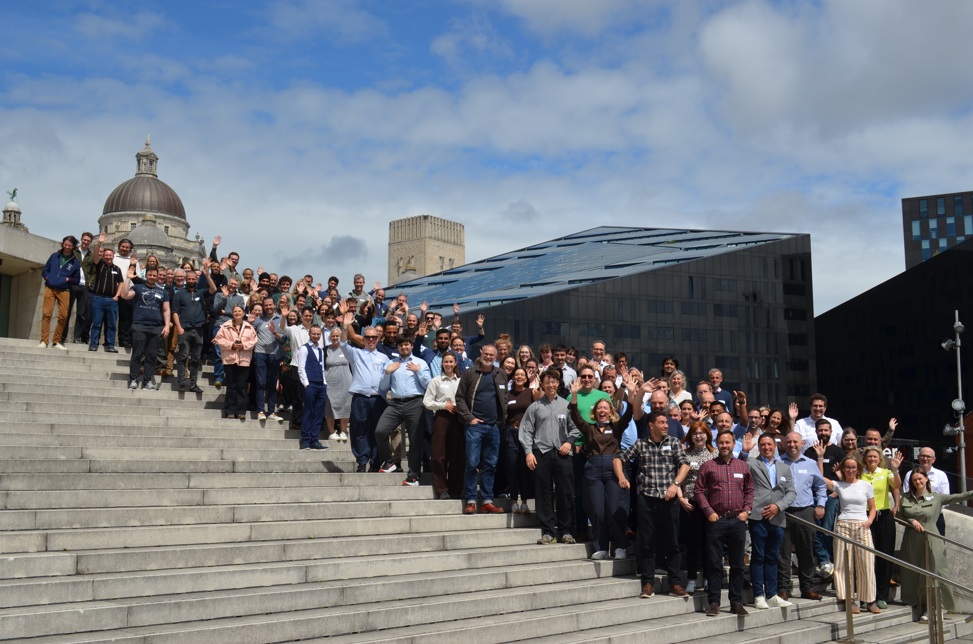
ODP General Meeting
2nd November 2026

Slide 2
What's the purpose of this meeting?
When is it? Monthly, first Monday of the month
Who is it? Everyone involved in Open Digital Planning (over 222 LPAs, delivery partners and the MHCLG team)
What is it for? It's our opportunity to give updates, share opportunities, showcase some of the work happening in the community, and (sometimes) bring in speakers from elsewhere that are relevant to the work we do
Is it recorded? Yes, and we add the video to the ODP hub
Notes:
Read words on slide
Don’t forget to introduce yourself Tom!

Slide 3
Oxford City Council's
Digital Planning Journey
Lan Nguyen
Planning Digital Transformation Lead

Slide 4

Oxford City Council’s
Digital Planning Journey
ODP General Meeting | October 26
Lan Nguyen | Planning Digital Transformation Lead

Slide 5
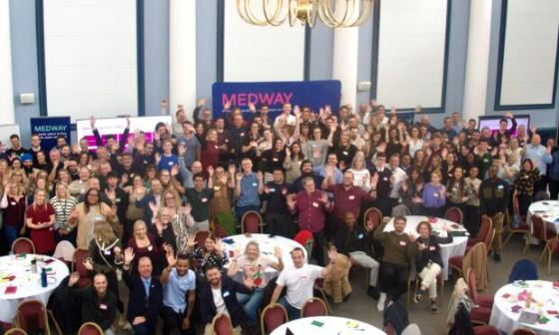
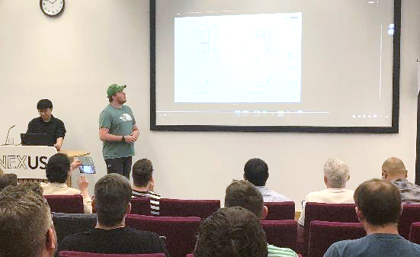
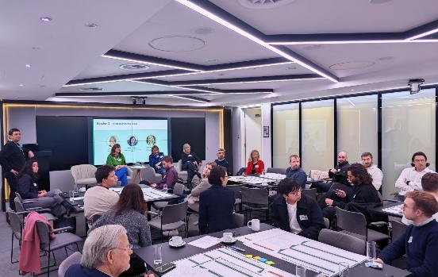
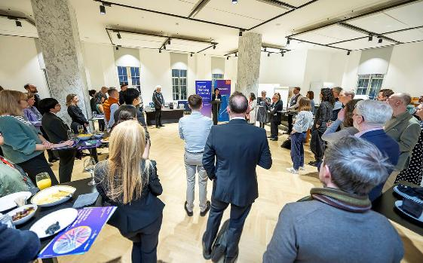
01 Joining The ODP Community
Active in ODP and digital planning
Joined ODP via DPIF Cohort 3; attendance of events, contributions to research and sector engagement
Role sits in Policy’s Data Analysis & Monitoring team, alongside senior data analyst and senior spatial officer
Lead monthly Digital Board with the Planning Director and team leaders to share ideas and progress
Monthly Policy, DM and UDH sessions drive digital adoption and best practice
Monthly Uniform SuperUsers group: 28 staff sharing knowledge and learning
Progress so far:
DPIF digital maturity (1) and datasets complete
Staff digital training programme for department started
PowerBI, GIS, AI and improving data quality
Uniform Cloud Migration Project complete
Horizon scanning and research collaborations
ODP Camp with DM team, Medway, 2025
Planning Innovation Hackathon,
3rd Prize, Leeds, 2025
Connected Places Catapult: Planning Innovation Forum, London, 2025
Digital Planning Directory: Education Launch
KCL, London 2026

Slide 6
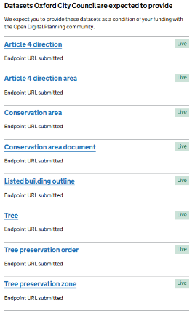
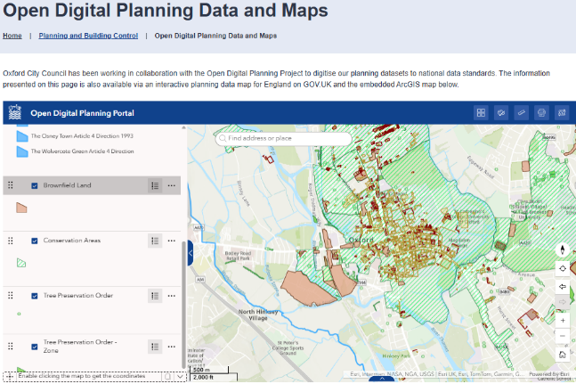
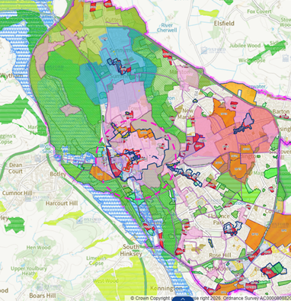
02 DPIF Standardised Datasets, Spatial data
Part 1: DPIF Datasets Published!
Part 1: Worked alongside data owners (Policy, Heritage, Trees teams, ICT) to update, approve and publish all DPIF datasets (3000+ records):
1590 Listed Building Outlines + Curtileges (UDH + HMLR + ICT)
1350 TPOs (Trees Team + ICT)
130 Brownfield Sites (Policy + ICT)
18 Conservation Areas (UDH + ICT)
5 Infrastructure funding statements (Infrastructure + Data + ICT)
4 Article 4 Directions (Policy + UDH + Legal + ICT)
Part 2: Followed up with DM officers and Senior Spatial Officer to catalogue and create planning self-service single source of truth across GIS, Uniform, Website
Highly recommend GIS courses by PAS and City Science, excellent learning resources offered through ODP
Part 2: OX Maps 50+ frequently used layers for internal planning self-service: LP and constraints all in one place. Saves substantial amounts of time finding relevant data.
“I’ve waited for this map for 11 years!” Principal DM Officer
© OGL 3.0; Crown Copyright and database rights 2026. Ordnance Survey AC0000808820.

Slide 7
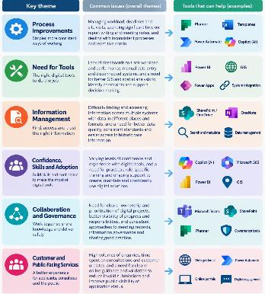

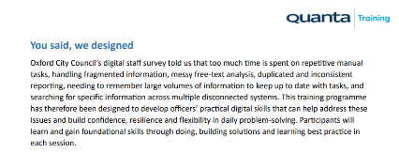
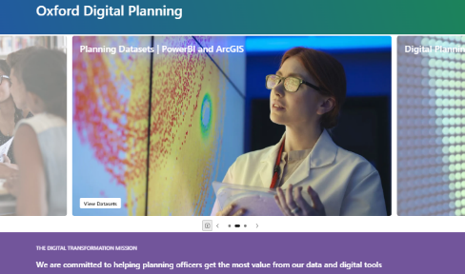
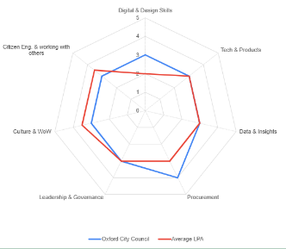
03 DPIF: Delivering a digital foundations learning and development programme
Used DPIF funding to build digital foundations programme. ADKAR Change management; increasing cultural desirability of digital solutions, improving shared knowledge, and supporting adoption.
Monthly informal meets across planning to increase awareness and desirability of digital. Leadership workshop to gather feedback and buy-in
Digital survey identifying needs. Thematic analysis of key topics, processes and tools to focus on.
Procurement of training provider. Budget planning to optimise attendance.
Design of bespoke courses. 155 bookings across 21 courses Q3: 5 M365 Courses, 14 Uniform Courses, 2 GIS Courses
Run training and gather feedback for Q4 courses and consultancy. Kirkpatrick monitoring + DPMA.
Share training materials and follow up in monthly digital meets to support application of learning
Thematic Analysis of Needs
(56 responses)
Design of Bespoke Programme (M365, Uniform and GIS)
Sharing learning and collaborating
Monitoring and Evaluation (DPMA)

Slide 8
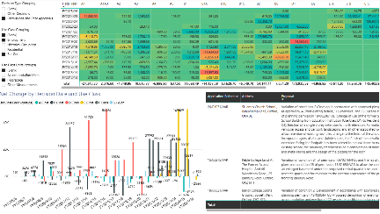
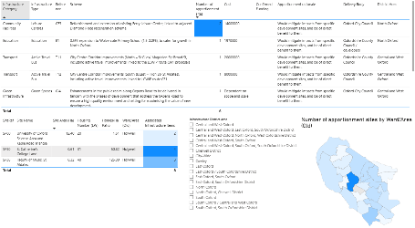
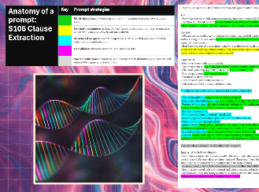

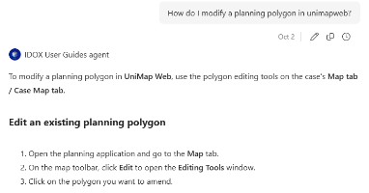
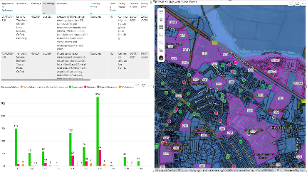
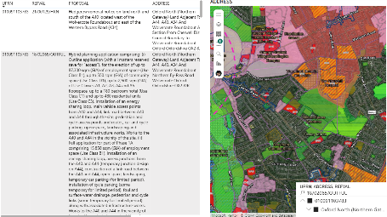
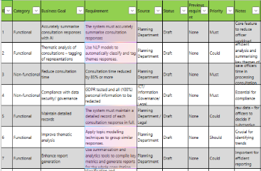
04 PowerBI, GIS, AI: Improving use of tools and quality of data
PowerBI and ArcGIS integrations, data from Uniform and other sources
Copilot Training and Pro Licenses
Structured Data Extraction
Knowledge Retrieval
Monitoring, reports, caseloads, data quality
IDP Infrastructure Mapping
Relating schemes to sites and regions
Data Entry, Quick data summaries and free-text analysis
Mapping applications by policy,
Planning status, SHLAA, site allocations, site visits
Site History, UPRN, Address
© OGL 3.0; Crown Copyright and database rights 2026. Ordnance Survey AC0000808820.

Slide 9

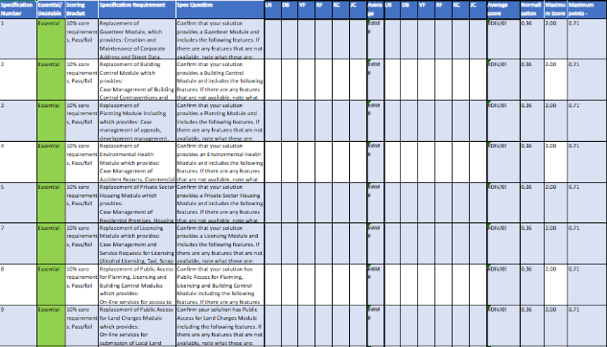
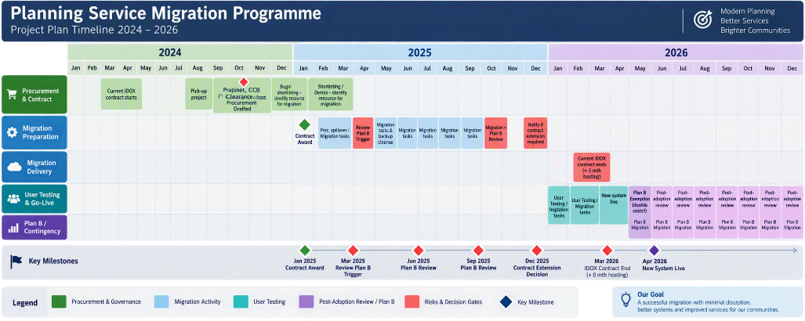
05 Back-end Systems Cloud Migration Procurement
Delivered an 18-month cloud migration of Planning and Regulatory systems for 132 users.
Researched UK planning systems and co-designed requirements with staff and TerraQuest.
Established project board (legal, procurement, finance, ICT, service leads). Bespoke procurement and contract to reduce risk.
Secured governance approvals: Cabinet, DPIA, EQIA, evaluation criteria, legal T&Cs and requirements (Functional, non-functional, demo, costs, support, delivery plan, social value).
20+ officers across services reviewed supplier demos.
Awarded the supplier and followed with a managed migration, UAT, downtime and integration assurance across PowerBI, RPA and GIS.
Completed migration and formed a supplier-trained Super Users group for issue-sharing and collaboration.

Slide 10




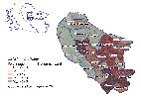

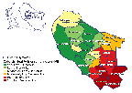
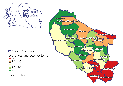


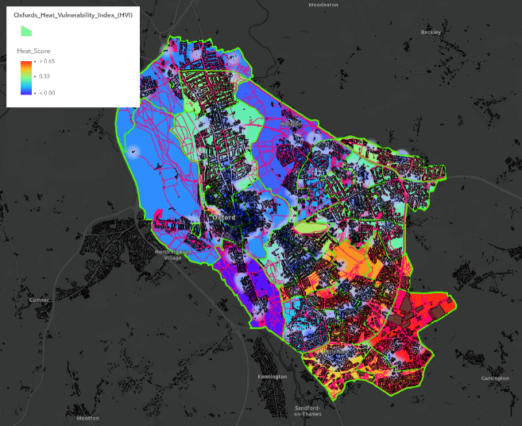
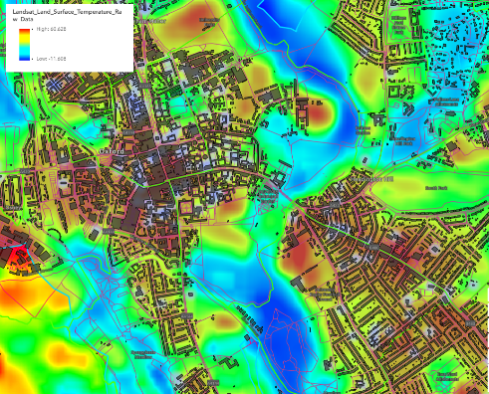
06 Satellite Applications:
Climate Resilience Research for Planning
Heat resilience and vulnerability datasets Created by Ben Ibbotson and Harrison Chivers
© Esri, Intermap, NASA, NGA, USGS | Esri UK, Esri, TomTom, Garmin, GeoTechnologies, Inc, METI/NASA, USGS
Urban temperatures are rising with climate change. Research collaboration with Satellite Applications Catapult, hosting University of Exeter student. Worked with ES and Planning Policy teams on heat vulnerability and resilience.
Created a heat vulnerability index: using demographic, built-environment (building density, cooling centres), heat, transport and green-infrastructure (canopy cover) datasets.
Working with ES teams to contextualise findings and strengthen multi-dataset GIS analysis.
Further research involvement with Extract, Digital Local Plans and the Digital Planning Register.
Landsat Max surface temperatures – Infrared Satellite image © NASA/USGS Landsat Program 2026

Slide 11
ODP Autumn Event Norwich
Josh Codjoe

Slide 12
ODP Winter Event
Jonathan Hodge -
Blaby District Council

Slide 13

Our winter event!
Scan the QR to register now!
Hosted by Blaby District Council on 10th December 2026
Practical, interactive event focused on digital planning and service innovation
Showcase from Blaby on how they have maximised the Digital Planning Improvement Fund with a small team
Latest updates from the Extract
Interactive networking and breakout sessions with peers from across Planning
Workshop on Building Cyber Resilience into Digital Planning
Opportunity to share experiences, exchange ideas and take away practical insights

Slide 14
Tell your story!
We'd like to continue LPA showcase slots at future General Meetings
If you'd like to take a 10-minute showcase slot, please get in touch with Tom
Showcases are the same short story-telling moments we have at our in-person events, opportunities to hear from the range of LPAs in ODP and all the interesting work happening!

Slide 15
Next General Meeting - Monday 2nd November

