Slide 1
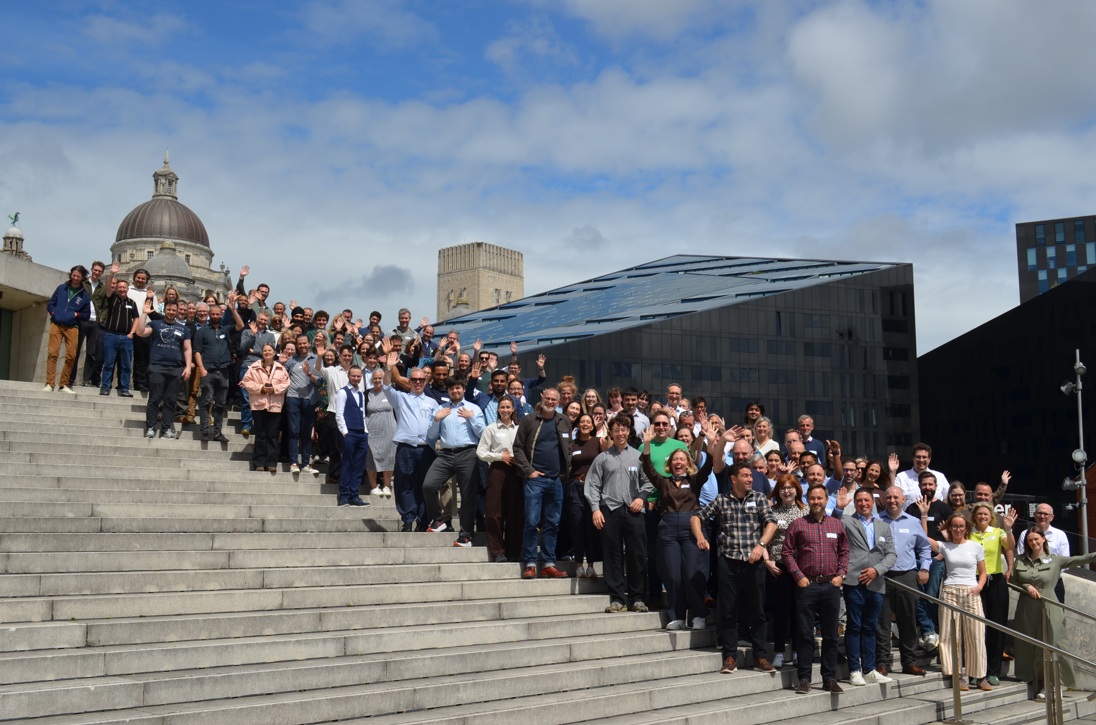
ODP General Meeting
7th September 2026

Slide 2
What's the purpose of this meeting?
When is it? Monthly, first Monday of the month
Who is it? Everyone involved in Open Digital Planning (over 222 LPAs, delivery partners and the MHCLG team)
What is it for? It's our opportunity to give updates, share opportunities, showcase some of the work happening in the community, and (sometimes) bring in speakers from elsewhere that are relevant to the work we do
Is it recorded? Yes, and we add the video to the ODP hub
Notes:
Read words on slide
Don’t forget to introduce yourself Tom!

Slide 3
Agenda
  City of London / Unboxed, Digital Local Plans project: Nikki Webber & Laura Smith
  Local Plans Team Update: Radhika Trivedi & Andy Moncur
  Camden Digital Planning Register Update: Stefan Webb
  LPA’s & Extract: Chanelle Williams
  Proptech R6: Alphie Murphy-O'Reilly
Notes:
Unboxed / City of London, Digital Local Plans project - Louise Smith: 10 mins
Local Plans Team – Radhiki & Andy 10 mins
Camden DPR: 15 mins
Lambeth - Mera: 10 mins
Extract / Chanelle: 10 mins

Slide 4
Unboxed / City of London
Digital Local Plans project :
Nikki Webber – City of London
Laura Smith - Unboxed

Slide 5

Digital Local Plans
Discovery / Alpha
LPA General Meet | 7th Sept 2026
Notes:
Nikki

Slide 6
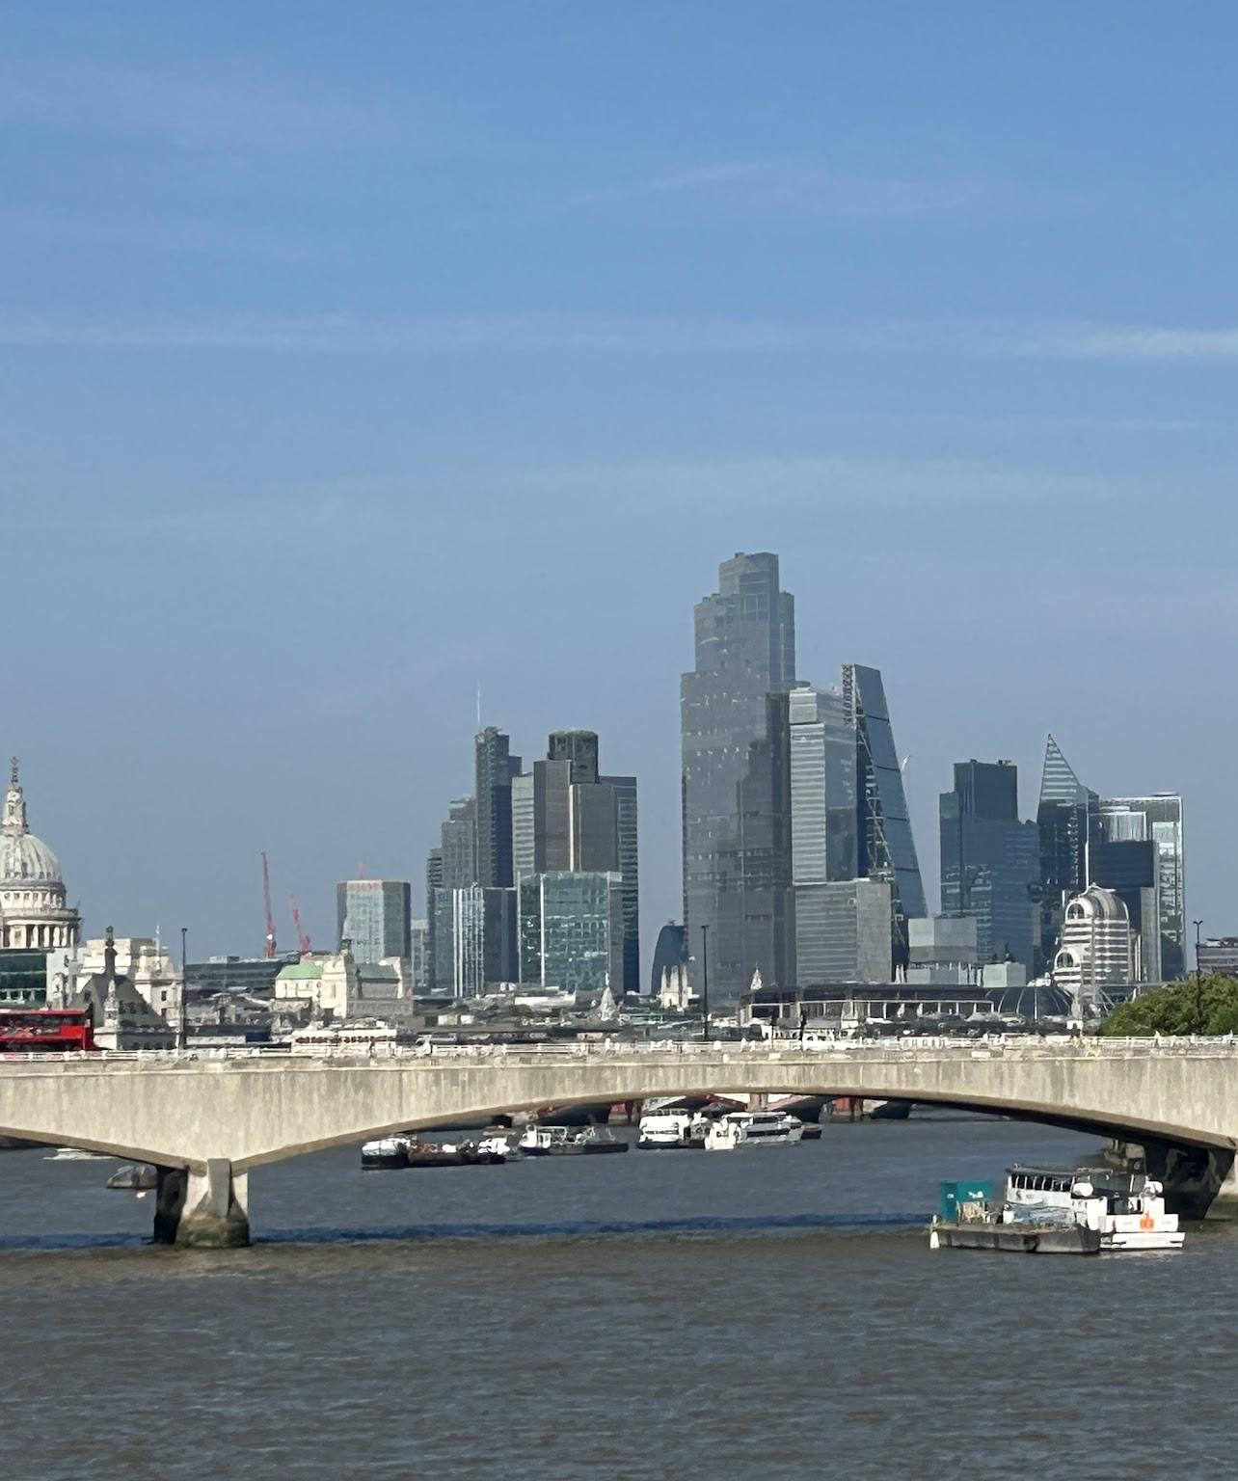
What we’ll cover
Project vision
Team
Story so far
Value proposition
Prototyping approach
How to get involved
Notes:
Nikki

Slide 7
A Digital Local Plan will create a connected system for plan-making. It will tell the story of how policies are produced making them more transparent, traceable, and easier to understand for everyone involved. This will enable faster plan-making, support greater local plan coverage and build trust.
Project vision statement
Notes:
Nikki - give background and context

Slide 8
Discovery
Alpha
Beta
Live
Exploring the problem space
Testing options with hypotheses
Building and refining options
Continuously improving
You can tell us what you need
You can co-design what might be
You can test how it works
You can use it
THIS PROJECT
Notes:
Nikki
What we’re doing in this project
It is a discovery and alpha phase, so early on in the process
Discovery is about exploring the problem space and Alpha is about testing options with hypotheses
In this phase you can help by telling us what you need and taking part to codesign potential solutions
If we progress on, Later phases will look to build something you can test and eventually use in your live services. (mention timetable)

Slide 9
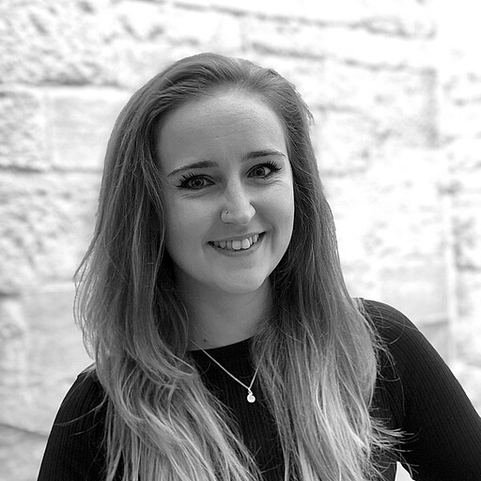

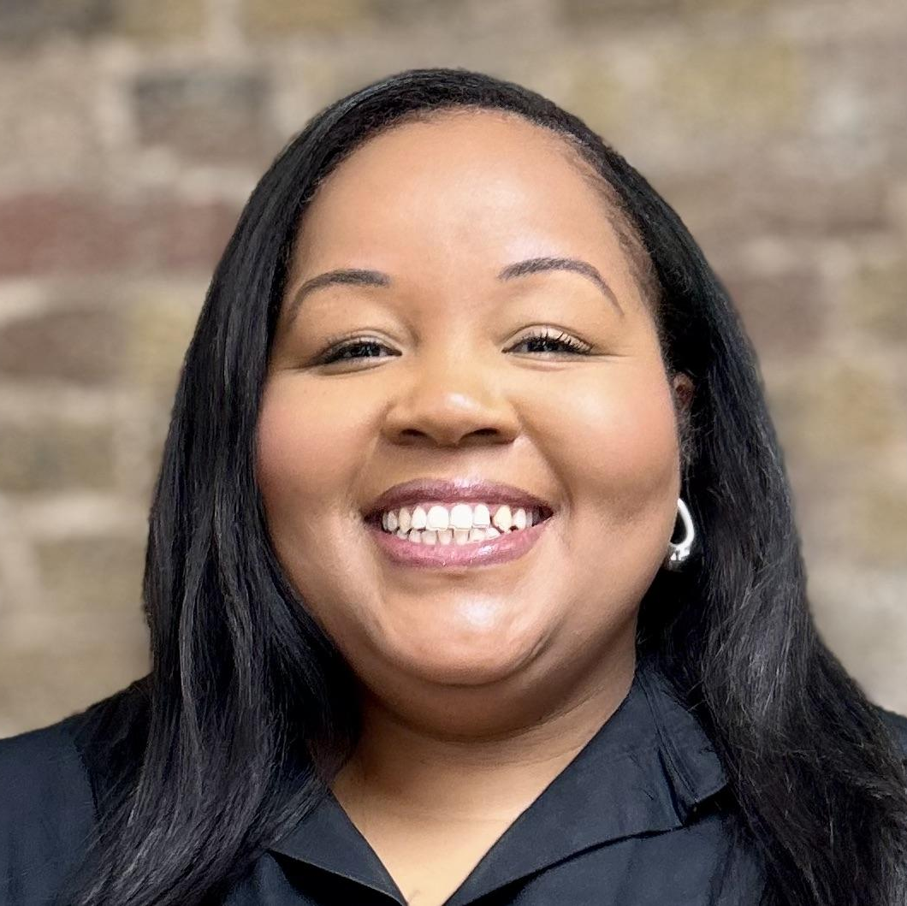
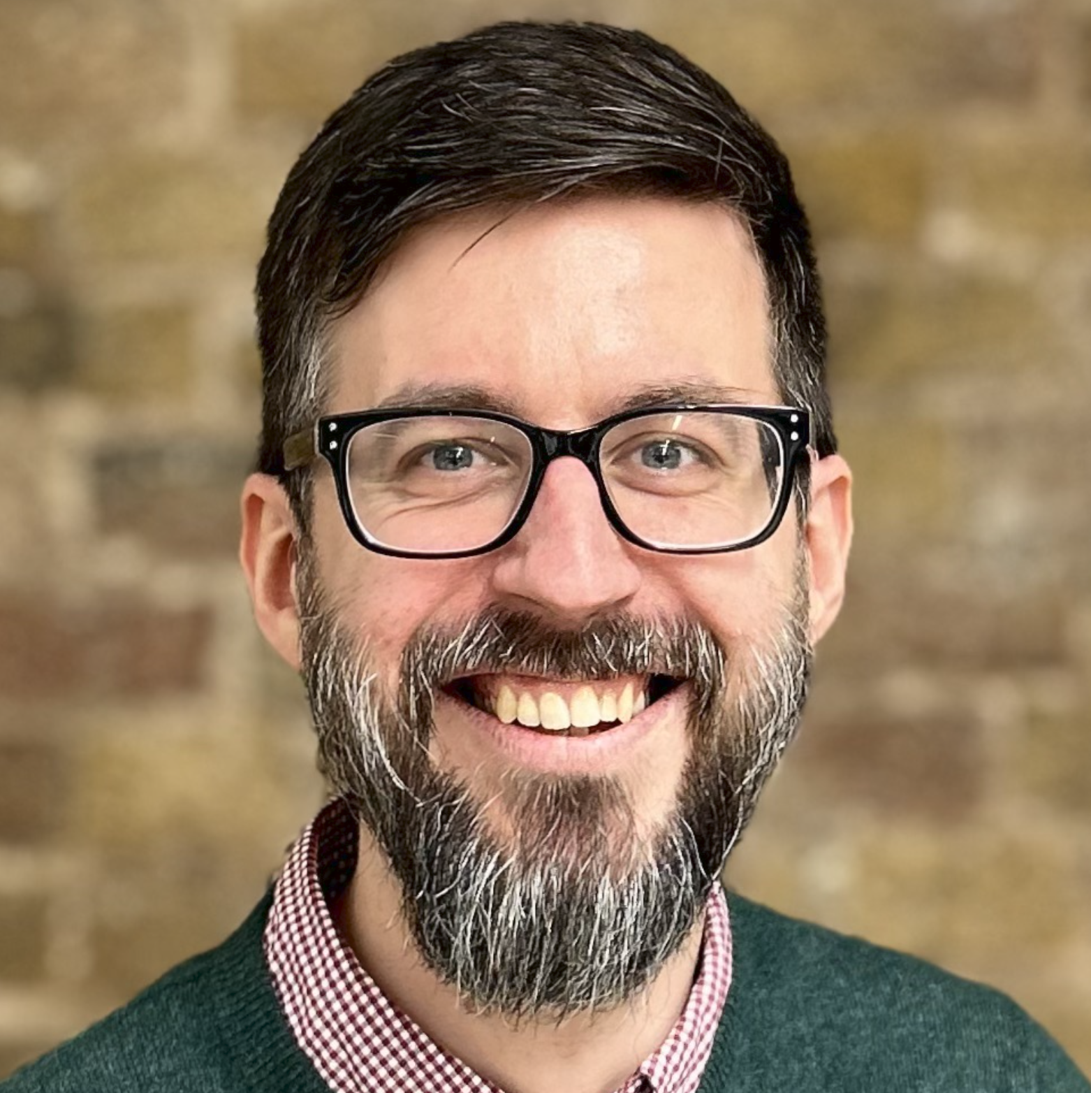
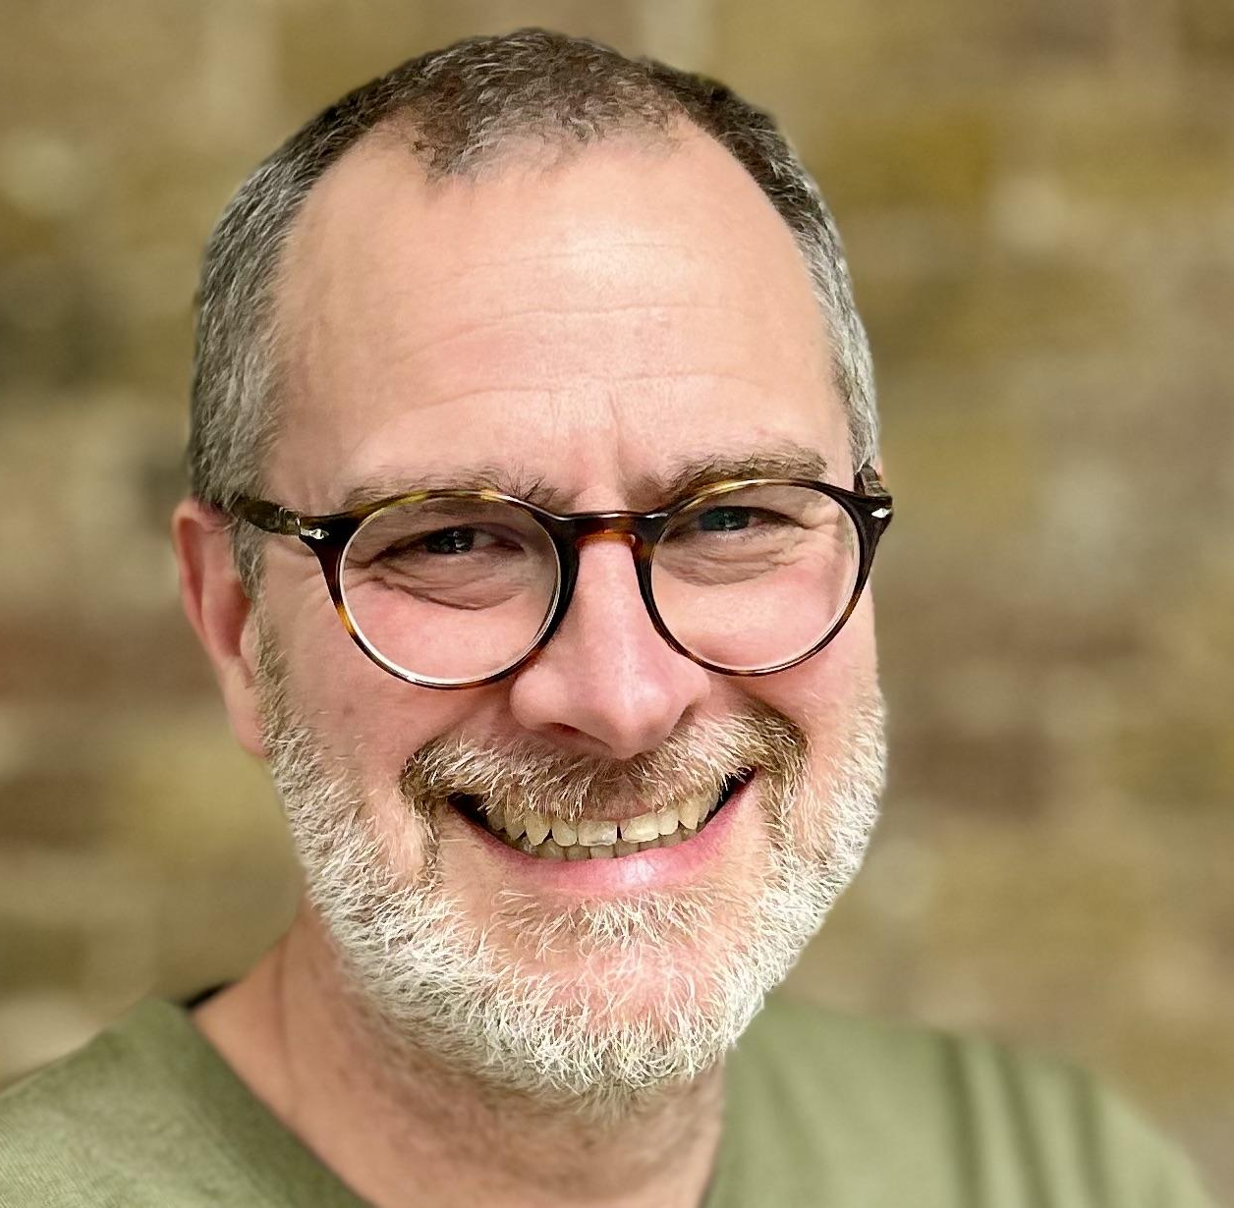
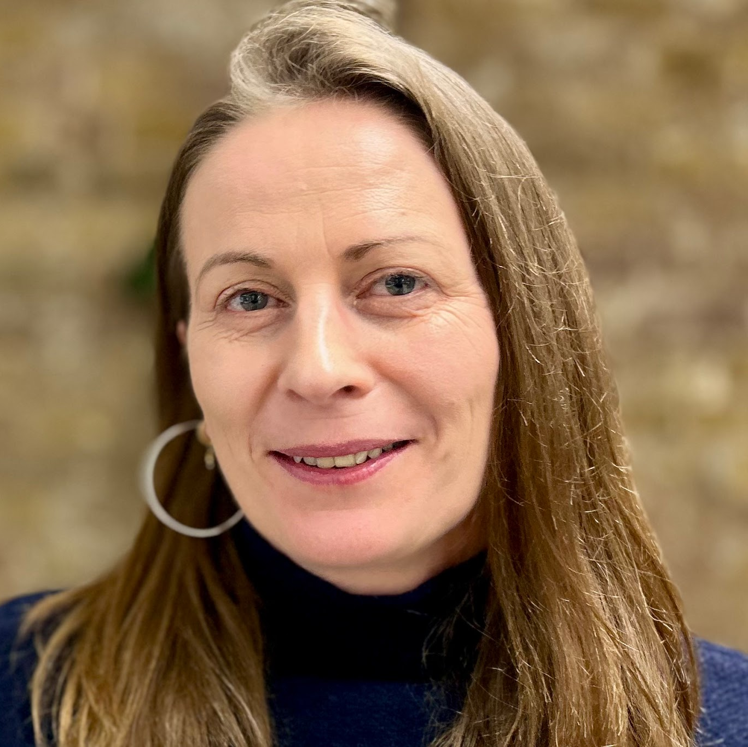
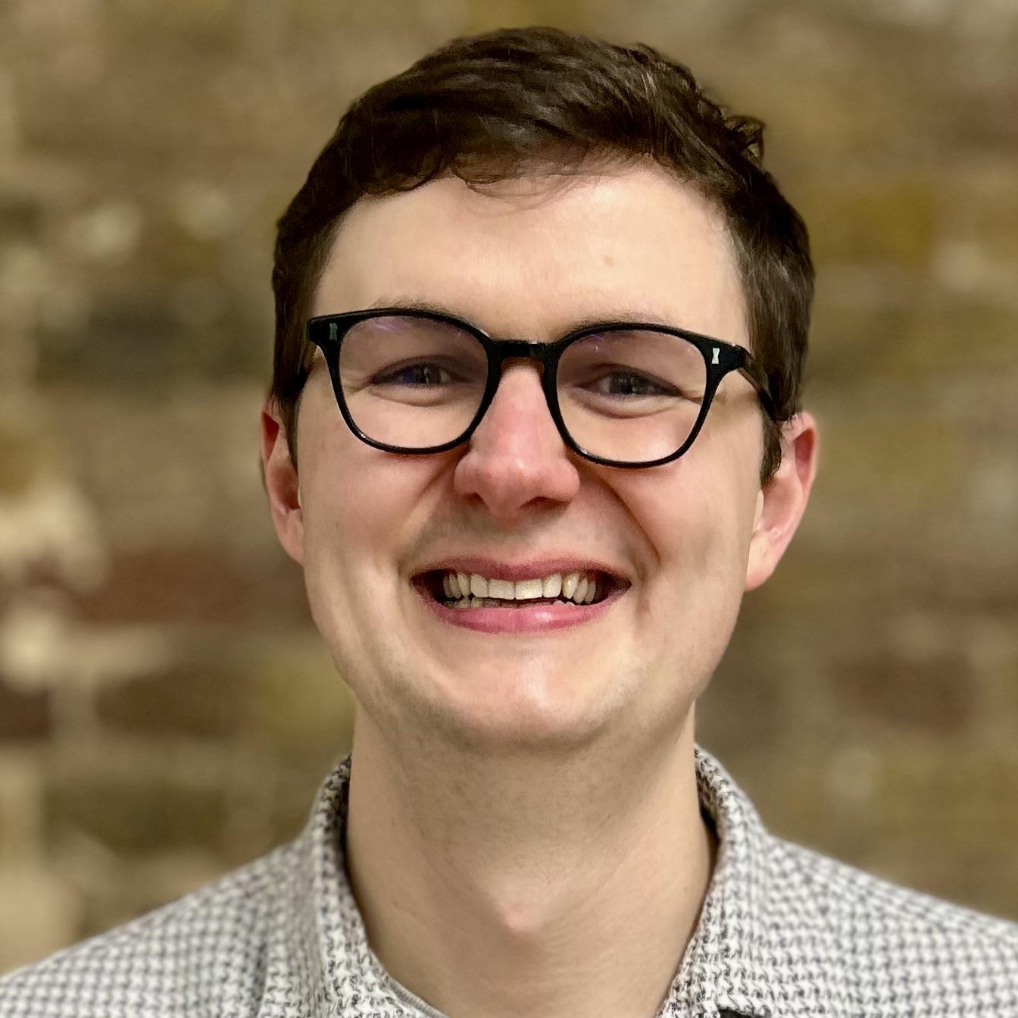
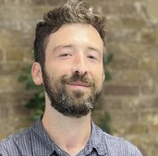
The Team
Nikki Webber
City of London
Conor Newman
City of London
Shaneek Glispie
Delivery manager
Ben Eskola
Developer
Martyn Evans
Head of Product
Laura Smith
Designer
Tom Gayler
Designer
Dan Daly
Developer
Notes:
Nikki

Slide 10
Prototyping
Notes:
Laura

Slide 11
Prototype map
Where can we add value to other parts of the ecosystem?
CULP guidance + regs
Call for sites
Consultations
Examination
DM decision making
Digital Plan Maker tool
Policy monitoring
Where can we add value to things that happen with the LPA plan-making system?
Evidence
Policy
Project management
Notes:
Laura
We’re thinking about what benefits we can have to things that are delivered or mostly happen in the wider ecosystem, maybe using third party tools - so those things on the top line
Then what direct benefit can we create for things are mostly delivered within the local authority - such as managing and using evidence or drafting policy
Realise there are some overlaps here, but it’s just helpful framing in terms of thinking about some indirect impacts we could have for other parts of the ecosystem, for example for PINS, maybe even for other proptech providers, such as those who provide consultation tools
Working with key stakeholders like PINS, also various people at MHCLG who are looking at different parts of the process such as evidence or call for sites

Slide 12
Our current focus
NOW
NEXT (ISH)
Evidence
Policy
Project management
Consultations
Examination
Service patterns:
what do these activities look like for different parts of the process?
Ingesting and structuring
Finding and using
Reviewing and analysing
Notes:
Laura
How can we create value
Is there an opportunity to standardise data or use spatial data to speed up this activity?

Slide 13
Prototypes
A few examples of what we’ve been doing…
Project Management
Create and publish Local Plan timetable to planning.data
Policy
Policy writing tool
Evidence
Structuring, tagging and grouping evidence
Notes:
Laura
Show a few examples of prototypes and concepts we’ve been working on

Slide 14
We need you!
Notes:
Laura

Slide 15
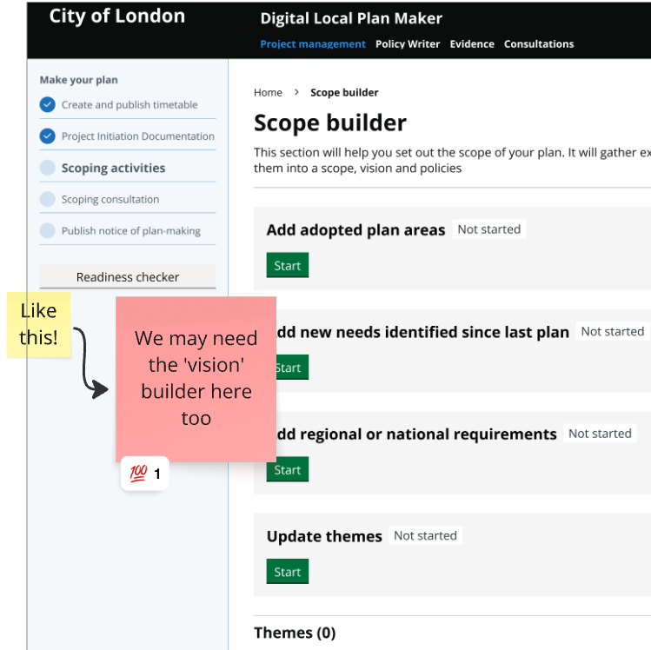
Design Feedback group
Join our fortnightly Design Feedback session (every 2nd Wednesday at 2.30pm)
See latest prototypes
Challenge our thinking
Share your expertise
Hear about how other LPAs tackle similar challenges
Notes:
Laura
Explain what the design feedback session is

Slide 16
Other ways to get involved
Lots of ways to participate:
Join the #digital-local-plan Slack channel
Set up an interview or take part in testing
Invite us to observe a meeting or show us something you’re working on
Help us connect with wider stakeholders
Join our Show and Tells
Notes:
Nikki

Slide 17
Get involved
email us:
laura.smith@unboxed.co
tom.gayler@unboxed.co
nicola.webber@cityoflondon.gov.uk
conor.newman@cityoflondon.gov.uk
Keep up to date with progress:
ODP Slack:
#digital-local-plan
Next Show and Tell:
Wednesday 9th September
Notes:
Nikki

Slide 18
Thank you
Notes:
Nikki

Slide 19
Local Plans Team Update: Measuring Key Outcomes
Radhika Trivedi & Andy Moncur

Slide 20
Help us shape the new Submit a Site for a Local Plan tool
WHY — Making Call for Sites simpler
We’re developing a new Submit a Site for a Local Plan tool to help standardise how site information is collected and reduce the manual effort for LPAs receiving, checking and managing submissions.
We’re now testing the tool with LPAs in real Call for Sites exercises — so we can test, learn and iterate with councils before wider rollout.
WHEN — Pilot happening now
Private Beta: now → December 2026
We’re looking for more LPAs that are planning to run, or are currently running, a Call for Sites between now and the end of 2026.
Taking part gives you the opportunity to use the tool with your Call for Sites and directly influence how it develops.
HOW — Get involved
Running a Call for Sites between now and December? We’d love to hear from you.
Participation includes:
onboarding and support from the Plan Making team
access to the Submit a Site tool
a dedicated support channel
regular opportunities to tell us what works — and what needs to change
Interested? Drop your details in the chat today or contact Andy Moncur / the Plan Making team after the call.
Notes:
Nikki

Slide 21
Camden DPR:
Stefan Webb

Slide 22
DPR update
Convertors and User Research
Stefan Webb, Nora Constantinescu, Anoi Atkinson

Slide 23
DPR to date
Planning application submitted via PlanX
Processed in BOPs
Published on DPR
Notes:
As a reminder - this is the first phase of work for DPR. This is the general flow

Slide 24
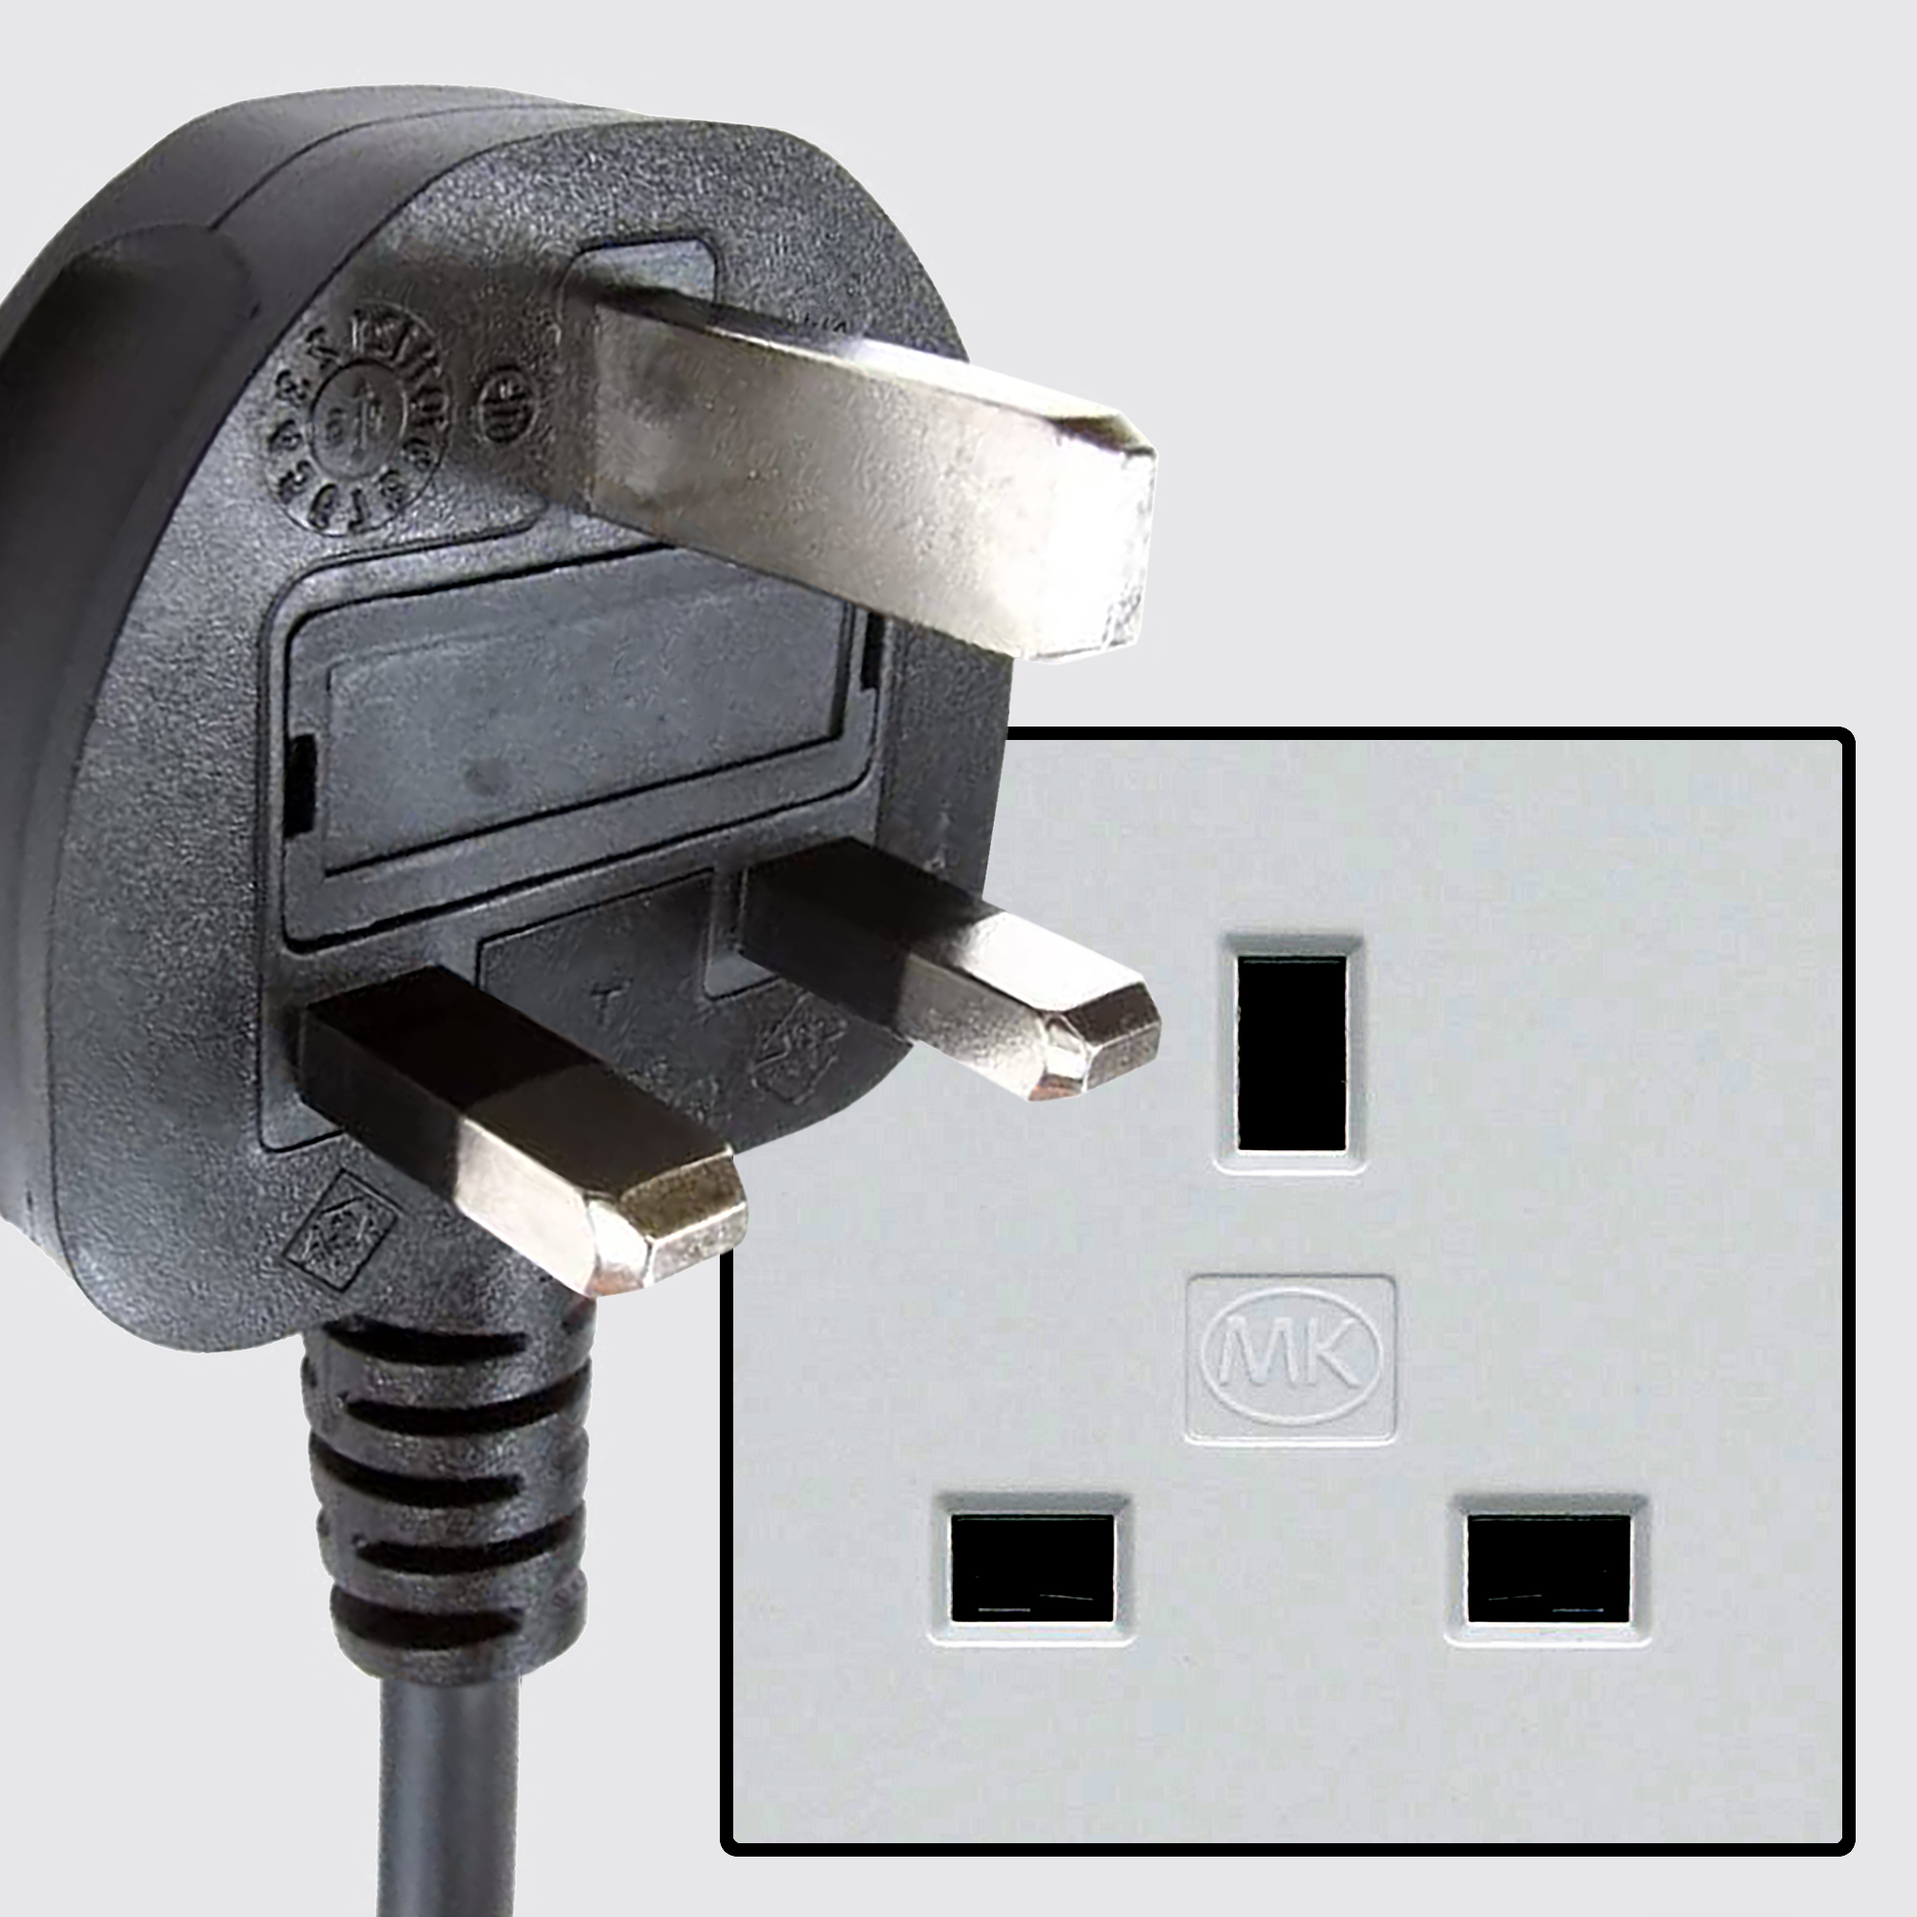
DPR to date
Planning application submitted via PlanX
Processed in BOPs
Published on DPR
However..
DPR
BOPS
Notes:
BOPs and DPR work well together. We can think of it like a matching plug and socket. If you’ve got a BOPs integration DPR plugs in nicely.

Slide 25
DPR to date
Only a small number of councils use BOPs
Only new applications are stored in BOPs and therefore only these applications are available on the DPR
Notes:
However - only a small number of councils have this intergration, and only a small number of applications are stored in BOPs.

Slide 26
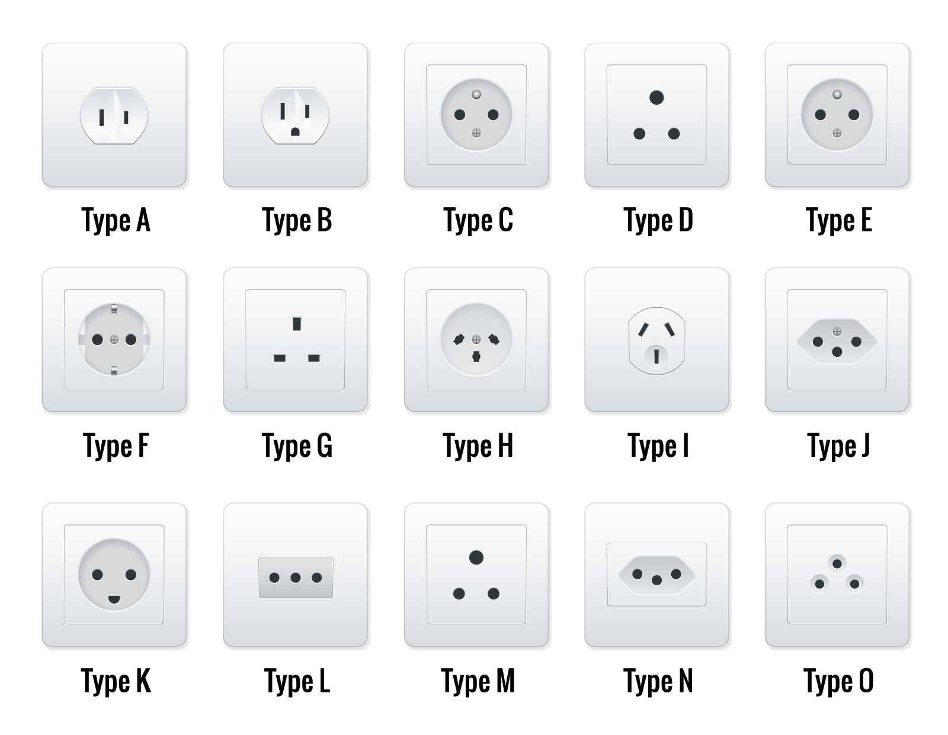
What’s the context we’re working in?
DPR
BOPS
Camden council holds new applications in BOPs. DPR only publishes these applications.
Other councils hold applications across a variety of databases and software system providers. The DPR cannot plug in.

Slide 27

We need to build a ‘convertor’
Notes:
We need some kind of convertor between the DPR as it is (a UK plug) and the rest of the world (all the other councils that have different sockets).

Slide 28
We need to build a ‘convertor’*
DPR
DPR X BOPs integration
Other councils - storing applications on different databases
Notes:
We’ve been calling this a ‘middle layer’. It’s here the analogy falls over. Back office agnostic.

Slide 29
*Sort of…
This is where the plug analogy falls over - we’re not building a convertor from scratch.
We’re investigating what can be re-used from the first phase of our work to build the DPR to create a back office agnostic solution to publishing on the DPR.
At a minimum, we will re-use the DPR schema.
We’ve previously been calling this the ‘middle layer’.
Notes:
We’ve been calling this the ‘middle layer’ and sometimes ‘DPR’ tooling

Slide 30
*Sort of…
The first phase of the DPR was great at publishing new application information to a public register.
In this second phase we’re investigating the biggest headaches around extracting and exposing data.
We’ve been conducting user research with LPAs and data consumers across the country.
Notes:
Once we understand this we can prioritise extraction and exposing the data that would have the biggest impact for LPAs. Building a convertor is a mega project and we’re not even sure it’s possible. So we’re prioritising finding out the data needs of LPAs and we’ll start by evolving the DPR as it currently stands so that the biggest problems are tackled first.
The first phase of the DPR was great at publishing new application information to a public register. - mention that only applications stored in BOPs can be published
In this second phase we’re investigating the biggest headaches around extracting and exposing data. - from other back office systems and day to day tools

Slide 31
What is the purpose of our research?
The research will explore how users currently access, use and reimport planning application data from their existing planning systems, and identify the challenges, dependencies and opportunities involved in these processes.
What are people doing every day, that’s messy, repetitive and inefficient?
Notes:
The research will validate whether users can confidently find email correspondence, use the available search filters effectively, correctly interpret search results, confirm whether an email was sent successfully, and navigate the interface independently without assistance..
This tool is primarily intended to support colleagues in CSC, CRT, CCT and potentially LBSO when responding to customer queries or complaints.

Slide 32
What did we find out?
“We just can’t feed data in and out in a way that we want to. It’s our data that’s meant for us and that’s the biggest frustration. We’d love that data as part of that submission to automatically populate in our back-office system.”
Doncaster LPA Participant

Slide 33
What did we find out?
“You spend more time doing like the admin side of things than actually assessing the applications. So, you’re spending a lot of time doing things that when you could be assessing applications and actually moving forward.”
Gateshead LPA Participant

Slide 34
What did we find out?
“There’s some applications where you’ve got to go back and look at, I don’t know, 200 documents to find three or four useful pieces of information. And then you’ve got to try and work out, you know, which is the relevant one, which is the one that’s been superseded, what’s actually relevant to what we’re doing now.”
Coventry LPA Participant

Slide 35
What did we find out?
“These tables must be cleaned and ingested into Fabric, a process
that is 24 hours out of date and prone to failure when firewalls or system configurations change”
Coventry LPA Participant

Slide 36
Assumptions Verified
Planning information is fragmented across systems and formats, creating manual administration, duplication, workarounds and downstream data-quality problems.
Users need a connected picture of applications, properties and places, bringing together planning records, site constraints, spatial information and relevant historic information.
Important planning information is still not consistently available as structured digital data, with historic records being important but inaccessible.

Slide 37
Assumptions Verified
Planning data serves a much wider set of needs than processing individual applications, including reporting, monitoring and other organisational uses, with different users requiring different views of the same underlying information.
Greater standardisation, interoperability and use of APIs could significantly improve access and reuse, including enabling more self-service.
The greatest opportunity is to capture information once and reuse it many times, reducing repeated effort while creating value across the organisation and for users.

Slide 38
What Next?
Notes:
As a reminder - this is the first phase of work for DPR. This is the general flow

Slide 39
How could a converter be useful to LPAs
Adopting DPR is still the priority - our research has been focusing on identifying the spillover benefits to deliver additional value early
Structured data for housing monitoring
DPR
Easy-access FOI answers
Spatial data querying
Display data from other back office systems
Notes:
We have been exploring X - these on the right are possibilities.

Slide 40
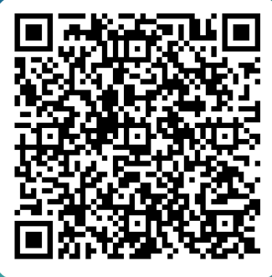
Digital Planning Register Survey
Notes:
We’ve been calling this a ‘middle layer’. It’s here the analogy falls over. We’re not

Slide 41
LPA’s & Extract:
Chanelle Williams

Slide 42

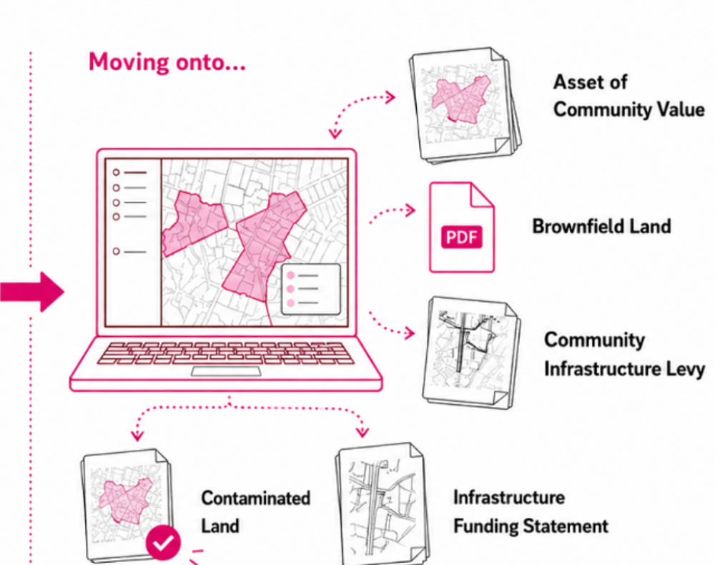
1
Extract is learning to work with more planning documents
We’ve built the first version of a more flexible Extract — so new document types can be set up without rebuilding the service each time.
Five types are helping us test it
Including Brownfield Land, Community Infrastructure Levy and Infrastructure Funding Statements.
Real LPA documents are shaping the detail
We’re using your examples to check what information should be captured and how it should be exported.
What this could mean: one tool that supports more of your historic planning records.
Extract | Built with Local Planning Authorities
Update: 28 August – 4 September 2026
Notes:
[Sources]
Extract weeknotes, 28 August and 4 September 2026
User-provided reference slide image f638c58e-f911-4293-9574-ef55d12c8fc1.png — illustration and visual direction

Slide 43
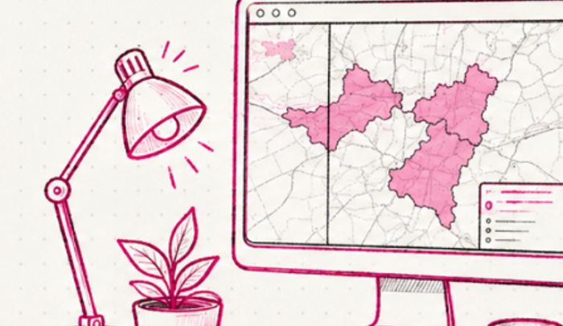
2
We’re testing the whole journey with LPAs
The aim is not simply to extract information — it is to make the result easier to review, trust and use.
Checking difficult documents
We’re testing challenging maps, georeferencing and the review experience — including the cases that need extra care.
Making the service more reliable
Better monitoring helps us understand where people get stuck and where Extract needs attention.
Learning about publishing
Research beginning this week will tell us whether publishing from Extract would genuinely help LPAs.
Built with LPAs: research and testing are guiding what we improve next.
How you can help: share examples or join a short research session.
Extract | Built with Local Planning Authorities
Extract | Built with Local Planning Authorities
Update: 28 August – 4 September 2026
Update: 28 August – 4 September 2026
Notes:
[Sources]
Extract weeknotes, 28 August and 4 September 2026
User-provided reference slide image f695bc74-36fc-4875-9ab6-0bc006ea584e.png — illustration and visual direction

Slide 44
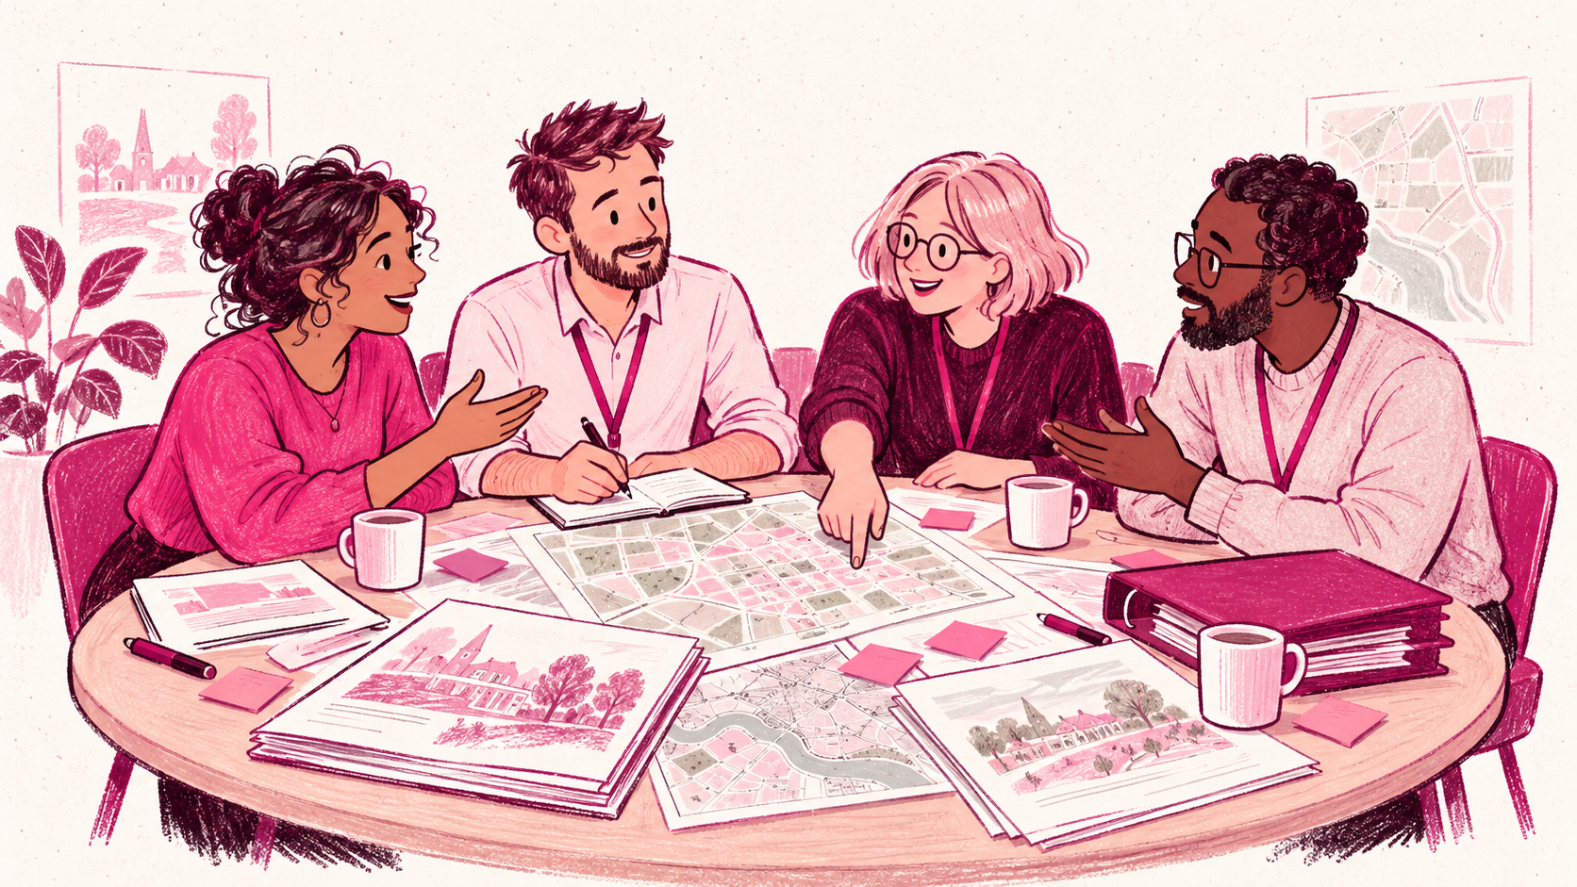
3
LPAs,
WE NEED YOU!
Meet Luke, our new User Researcher. He wants to learn from the people who know planning data best — you.
1
What gets in the way?
2
What data matters most?
3
Why would it help?
Where does improving planning data feel slow or difficult?
Which datasets would make the biggest difference to your authority?
What could better data unlock for planning work and services?
Got 30 minutes? Help us build Extract with LPAs.
Extract | Built with Local Planning Authorities
Extract | Built with Local Planning Authorities
Update: 28 August – 4 September 2026
Update: 28 August – 4 September 2026
Notes:
[Sources]
+- User-provided slide screenshots showing the duplicated graphics: 04bec5c1-942d-4fe8-8536-d1382934d150.png and 67ea8c34-e814-4b13-b63e-4543fe5ec99e.png (provided 7 September 2026).
+- User-provided Extract visual references: 9bb2e285-b45a-4be0-ab9e-45c0d63ac033.png and 31926927-cd7a-4493-b6ae-c3b33e5d83ba.png.
+- Slide 3 hero illustration: AI-generated for this presentation on 7 September 2026; generic people, no real-person likeness intended.

Slide 45
4
4,581 documents — and counting
LPAs across England are continuing to upload historic planning documents and help us improve Extract.
4,581 documents uploaded
Our highest total yet, across all time.
122 councils onboarded
That’s 40% of the 302 authorities whose planning data can be mapped.
Thank you — every document and every conversation helps us make Extract more useful.
Extract | Built with Local Planning Authorities
Update: 28 August – 4 September 2026
Notes:
[Sources]
User-provided metrics screenshots, 7 September 2026: 4,581 documents uploaded all time; 122 councils onboarded (40% of 302 mappable authorities)
User-provided reference slide image f638c58e-f911-4293-9574-ef55d12c8fc1.png — illustration and visual direction

Slide 46
PropTech Innovation Fund
Round 6 events

Slide 47
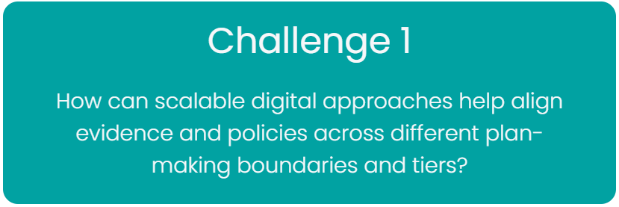
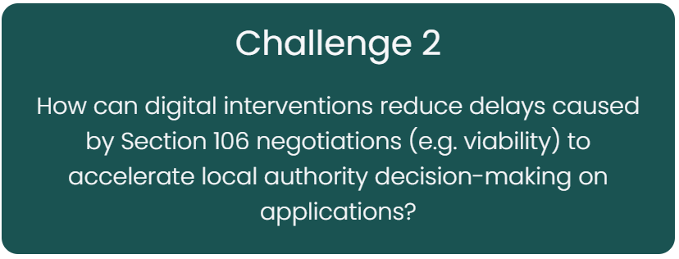
Upcoming events
Wednesday 30 September: Kick Off webinar
Monday 16 November: Disruptive Innovators Network webinar (focus on Challenge 2)
W/C 16 November: Catapult Connected Places webinar (focus on Challenge 1)
Feb 2027: Final Show Case webinar

Slide 48
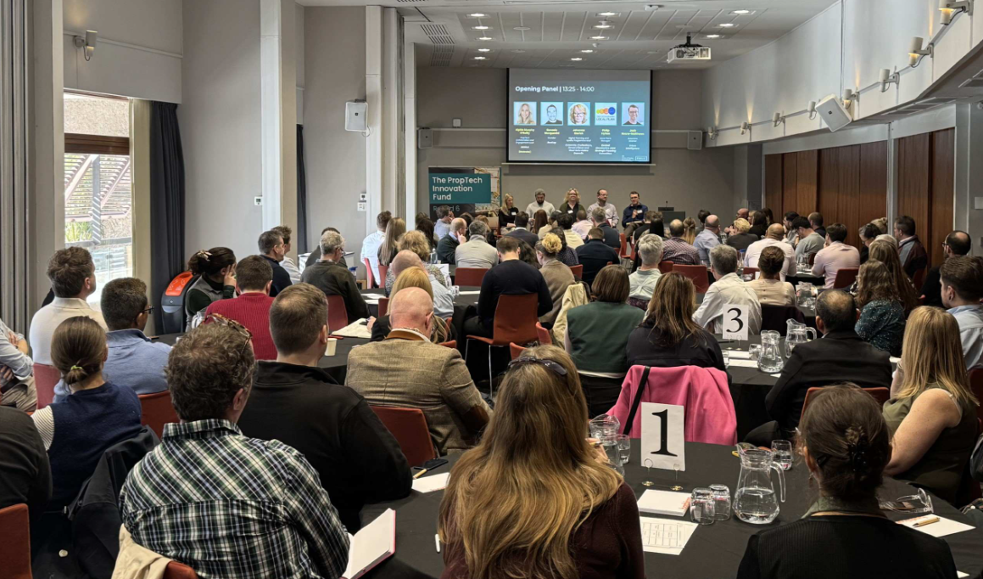
Engaging with ODP
Are we missing anything?
Would you like more events?
Would you like more updates?
Would you like more opportunities to engage?

Slide 49
Tell your story!
We'd like to continue LPA showcase slots at future General Meetings
If you'd like to take a 10-minute showcase slot, please get in touch with Tom
Showcases are the same short story-telling moments we have at our in-person events, opportunities to hear from the range of LPAs in ODP and all the interesting work happening!

Slide 50
Next General Meeting - Monday 5th October

