Slide 1
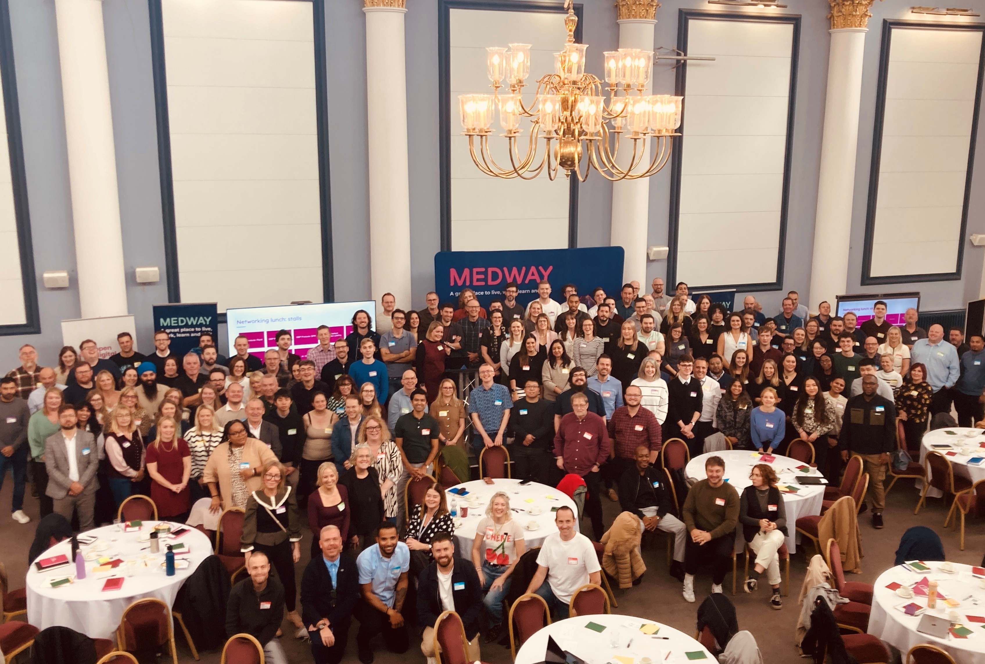
ODP General Meeting
2 February 2026

Slide 2
What's the purpose of this meeting?
When is it? Monthly, first Monday of the month
Who is it? Everyone involved in Open Digital Planning (over 223 LPAs, delivery partners and the MHCLG team)
What is it for? It's our opportunity to give updates, share opportunities, showcase some of the work happening in the community, and (sometimes) bring in speakers from elsewhere that are relevant to the work we do
Is it recorded? No, but we do add the slides to the ODP hub
Notes:
Read words on slide
Don’t forget to introduce yourself Tom!

Slide 3
Agenda
Extract intro and Demo: Chanelle & Gordon
Building Control: Jordan Lister, Tom Gayler and Catherine Neal
Proptech R6 Funding opportunity: Alphie Murphy O’Reilly
Spring event: Josh Codjoe & Chloe Swift
Volunteers for Digital Planning UR: Tom
Notes:
Tom

Slide 4
Extract
Notes:
Phil

Slide 5
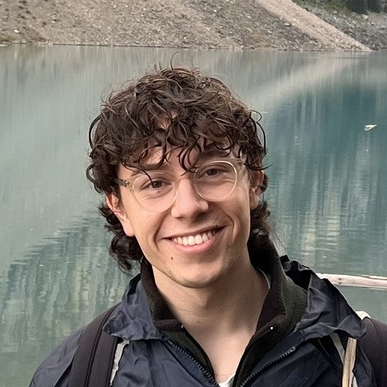
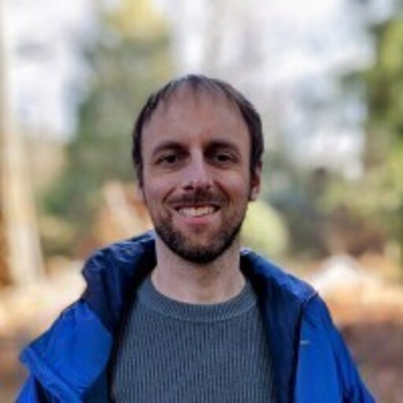
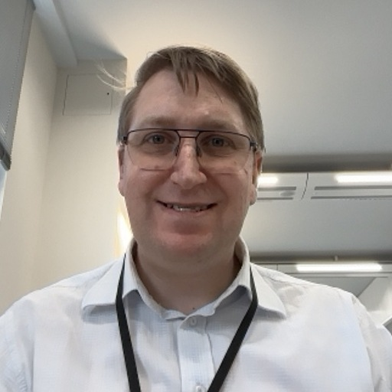

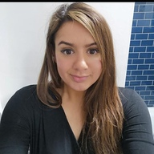
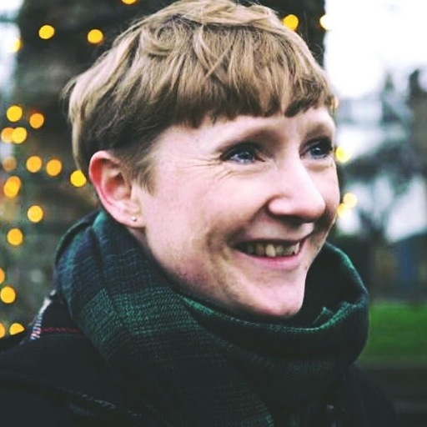
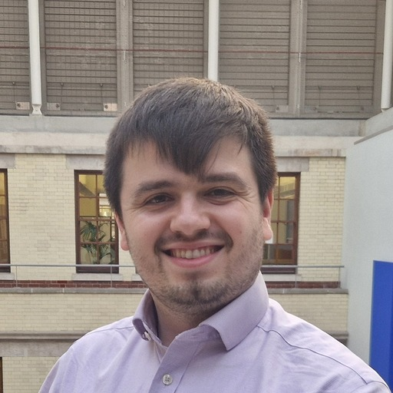
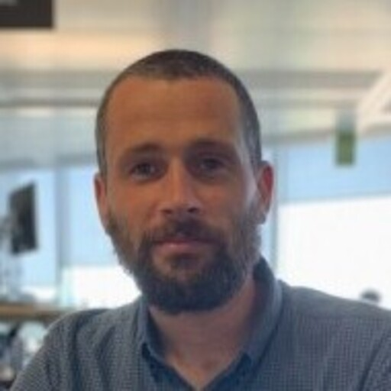
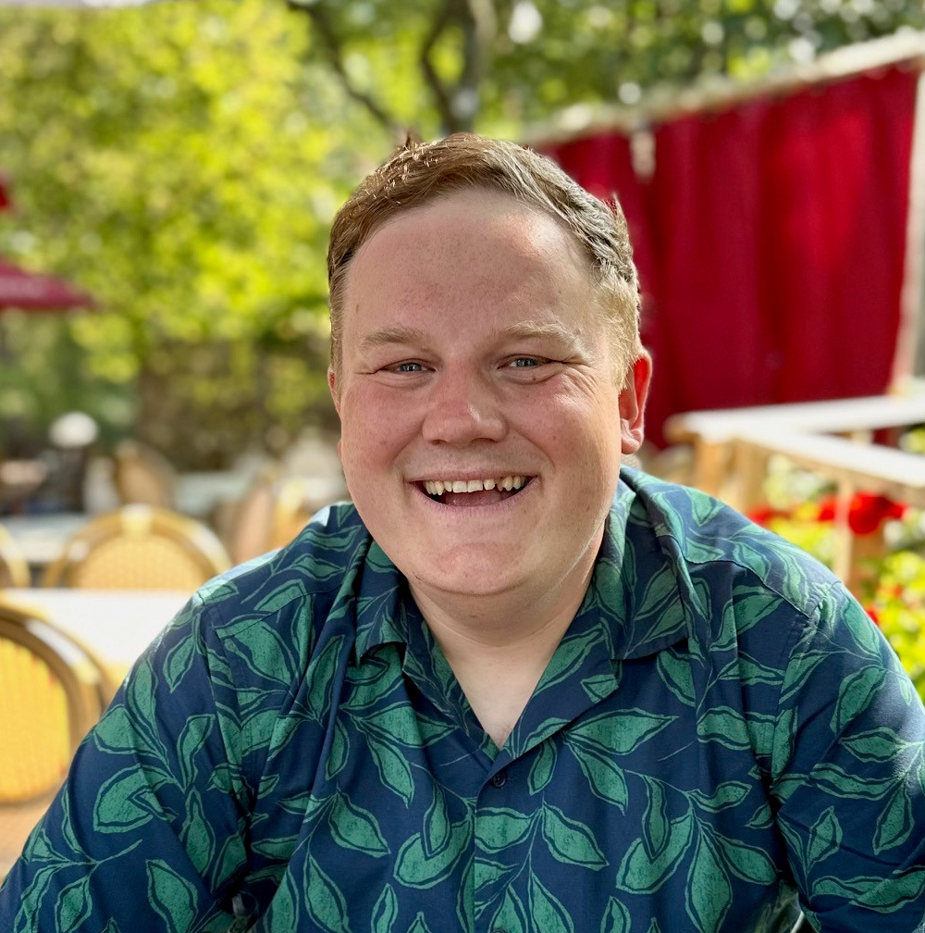
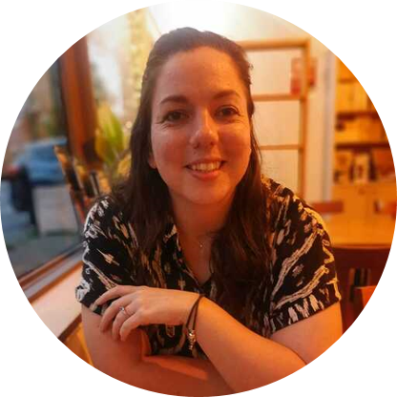
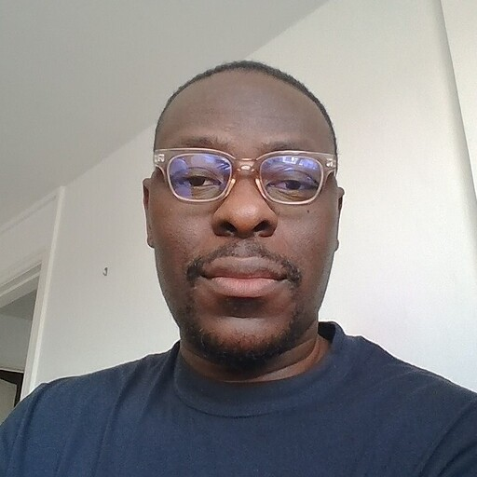
Who We Are!
Gordon Aiken
Product Lead
Chanelle Williams
Delivery Manager
Aydin Utting
Lead AI engineer
Kevin Etchells
Lead Frontend Developer
Richard Jackson
AI engineer
Rebecca Dodd
User Research
Heather Reeve – Black
Evaluation engineer
Nick Richie
Service Design
Ashley Poole
Applied AI engineer
Notes:
Today you'll be meeting a few members of the ODP team, who can introduce themselves as we go through the session
I'm Sarah I'm a Community Lead on the programme and will be taking you through the first section

Slide 6
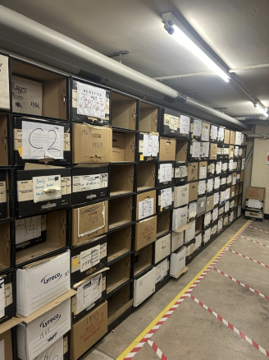
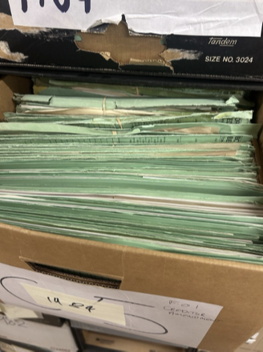
How do you solve a problem like the planning system?
We have valuable data locked away in paper documents. Constraints like Article 4 Directions, TPOs and Conservation Areas can be scanned, but remain inaccessible to modern software

Slide 7
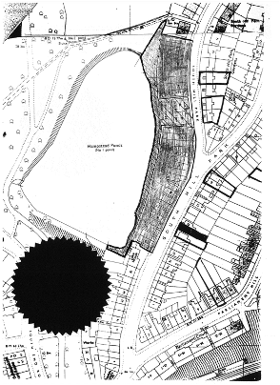
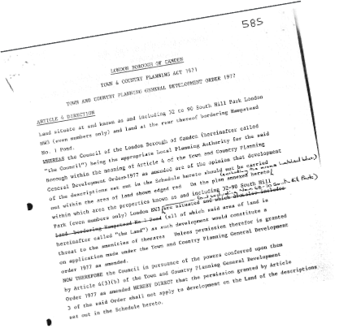
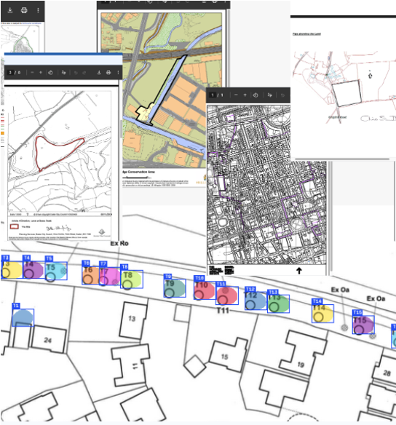
And there are challenges after documents are scanned...
2) Planning Constraints Locked in PDFs
1) Planning Data has huge variability
Codifying planning constraints as modern geospatial data
Areas, Map Points, Donut Polygons, MultiLineString, Inconsistent Data Formats
The result is:
Up to 2 hours for accurate spatial and unstructured data to be converted
100k's of documents across 9 core planning constraints

Slide 8
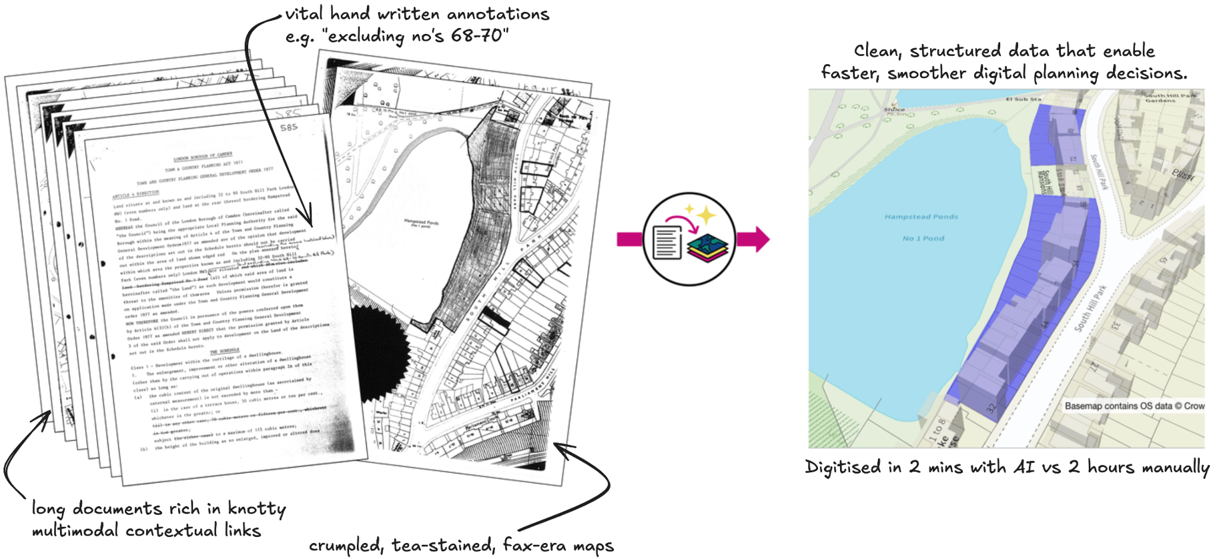
Extract: Documents to Data
A tool for automatically transforming planning documents into modern geospatial data

Slide 9
Extract Demo
Notes:
If of interest please put your name down. Samatha and Thomas

Slide 10
What Next!
Extract are attending and Demoing at ODP Event in Keswick 2026!
Questions? - Extract Drop-in every 2nd Tuesday or find Chanelle Williams via slack
Ask: LPAs who have not fully digitalised TPO's/Article 4/Conservation who would like to assist with User Research both in person/online!

Slide 11
Lambeth Building Control: Tom Gayler
Notes:
Sign up shout out, Josh?

Slide 12
PropTech Round 6 Funding: Alphie Murphy O’Reilly
Notes:
Sign up shout out, Josh?

Slide 13

PropTech Innovation Fund – Round 6
Working with PUBLIC to make £2.4 million available across up to 12 pilots, focused on two challenge areas.
Seeking innovative solutions to tackle systemic barriers in planning and housebuilding, supporting delivery of 1.5 million homes during this Parliament.
Want partnerships to apply, including local authorities, developers and technology suppliers, testing solutions in real-world environments for lasting impact.
Applications open on 4 March.
Challenge 1:
How can scalable digital approaches help align evidence and policies across different plan-making boundaries and tiers?
Challenge 2:
How can digital interventions reduce delays caused by S106 negotiations (eg viability) to accelerate local authority decision-making on applications?

Slide 14
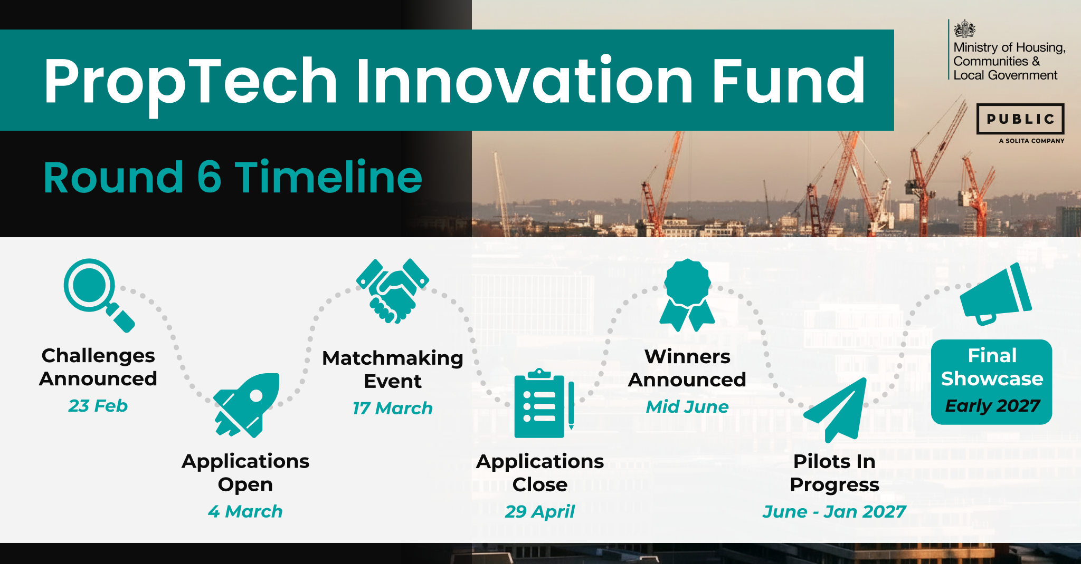
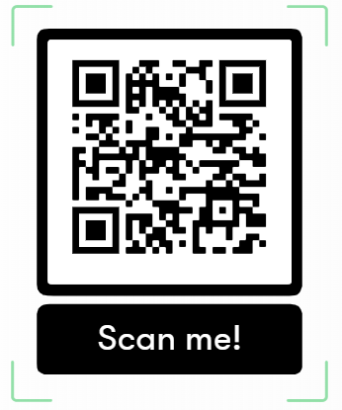

Slide 15
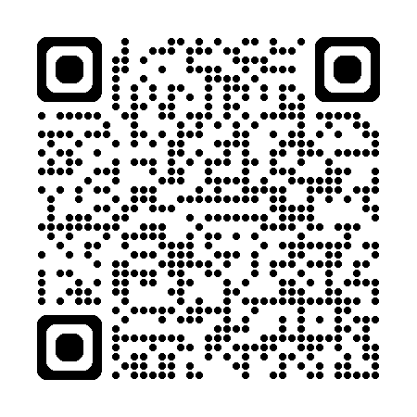
PropTech Innovation Fund Survey
Since 2021, the PropTech Innovation Fund has supported councils to test and adopt innovative approaches to planning and housing delivery processes.
If your council has taken part in the fund, we want to know how it has helped you adopt digital tools and embed digital planning practices into regular processes.
Please complete our survey before it closes this Wednesday, 4 March 2026.
Scan here to complete!

Slide 16
Spring event: Lake District National Park Authority
Notes:
Sign up shout out, Josh?

Slide 17

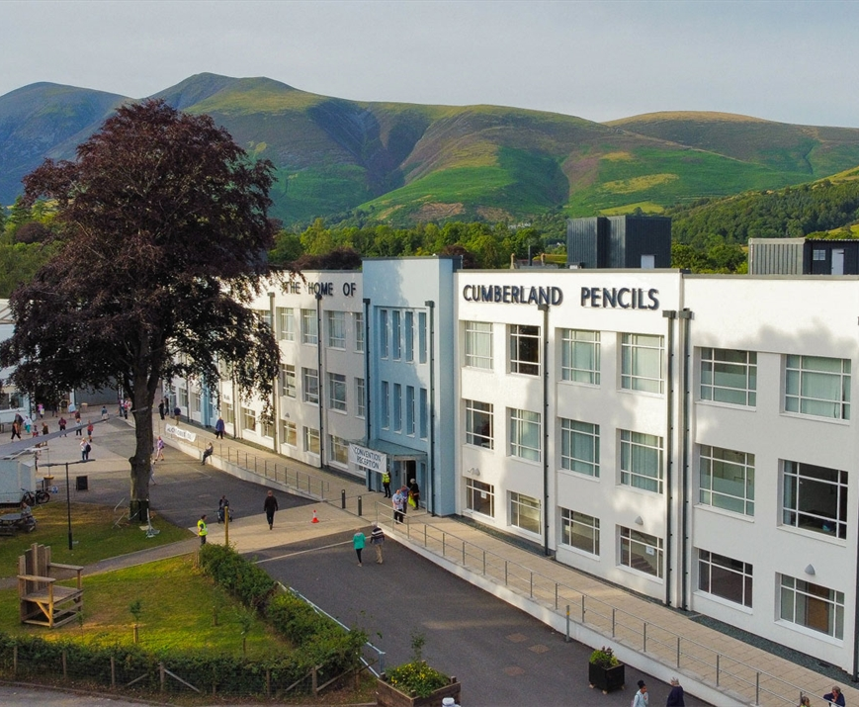
Lake District National Park Authority - Keswick
Registration for our next event hosted by the brilliant Lake District National Park Authority on Thursday 26th March 2026, 10am – 4pm is now closed! We've had over 100 registrations which includes a mix of 41 LPA's across the community.
Nestled in one of the UK’s most stunning landscapes, where tranquil lakes meet dramatic fells, this gathering will be a chance to step out of the everyday and into a space of fresh ideas, collaboration, and inspiration.
Venue: The Pencil Factory, Carding Mill Lane, Keswick, CA12 5NG.
Agenda will be shared in the calendar invite this week.
Notes:
Josh

Slide 18
MHCLG Digital Planning, the Chief Planner's Office, and Planning Inspectorate

Slide 19
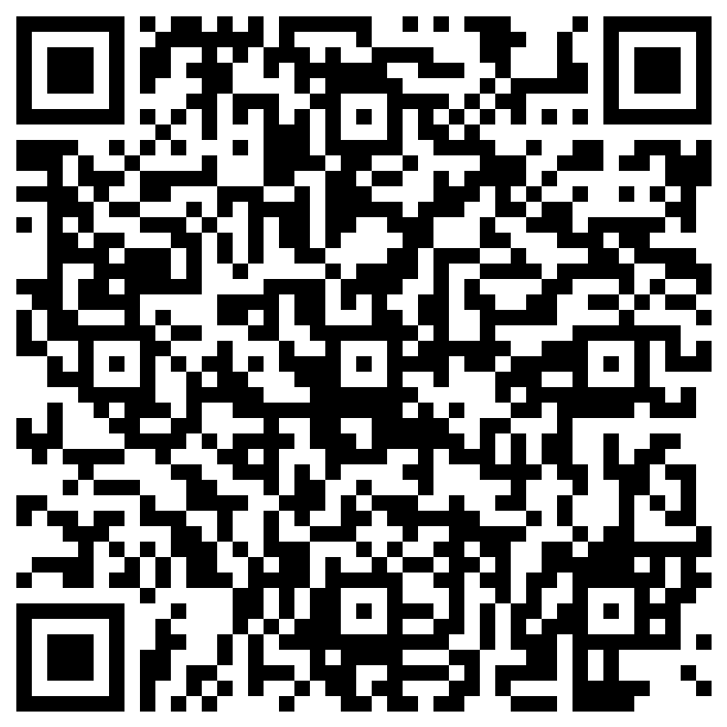
Making research participation better
We are exceedingly grateful to all the ODP members who have already put themselves forward to take part in research. But we know there are many more planning officers in the country than the 80 or so who are currently taking part in our research.
We know that some people are put off taking part in research because it might take up too much time.
The last thing we want to be is a burden. So our intention is to reduce the number of times we have to appeal to people to take part in our research, by growing the overall number of volunteers and then coordinating across different government organisations, so that the same person is not invited too often, out of sheer ignorance on the part of researchers.
This collaborative agreement has been reached across MHCLG's Digital Planning programme, the Chief Planner's Office, and the Planning Inspectorate. We imagine other government departments will be interested in collaborating with us when working with LPA's in the future.
If you have not already signed up to take part in research, please consider doing so via the link below, which is also linked to via the QR code:
Volunteer to participate in research for Digital Planning with MHCLG and OGD – Fill in form
Notes:
A message from our sponsor if you will (those being the Chief Planners Office, Digital Planning and the Planning Inspectorate), the ODP community packed with Planning specialist is now viewed by MHCLG as a prized asset to help test everything from emerging policies to new tools. We are mindful we don’t bombard you with requests for your insights, so we are asking you to sign up to pool/reservoir of willing contributors so we can manage the contact across the community and ensure we get to hear a range of voices.
Link will be in the chat
And as a prime example we have plea for 15 minutes of 5 or 6 planning officer time to test some new Local Plans approach being developed in house, Andy Moncur has popped into the chat

Slide 20
Tell your story!
We'd like to continue LPA showcase slots at future General Meetings
If you'd like to take a 10-minute showcase slot, please get in touch with Tom
Showcases are the same short story-telling moments we have at our in-person events, opportunities to hear from the range of LPAs in ODP and all the interesting work happening!
Monday 13th April at 1pm
Notes:
Finally is you are ready to talk about your journey in Digital Planning via Showcase, please get in touch so we can give you a slot on the next ODP general meeting on Monday 13th April

Slide 21
Thank you!
#all-lpa-general
Notes:
Checkout Slack #all-lpa-general each Friday for ODP overview

