Slide 1
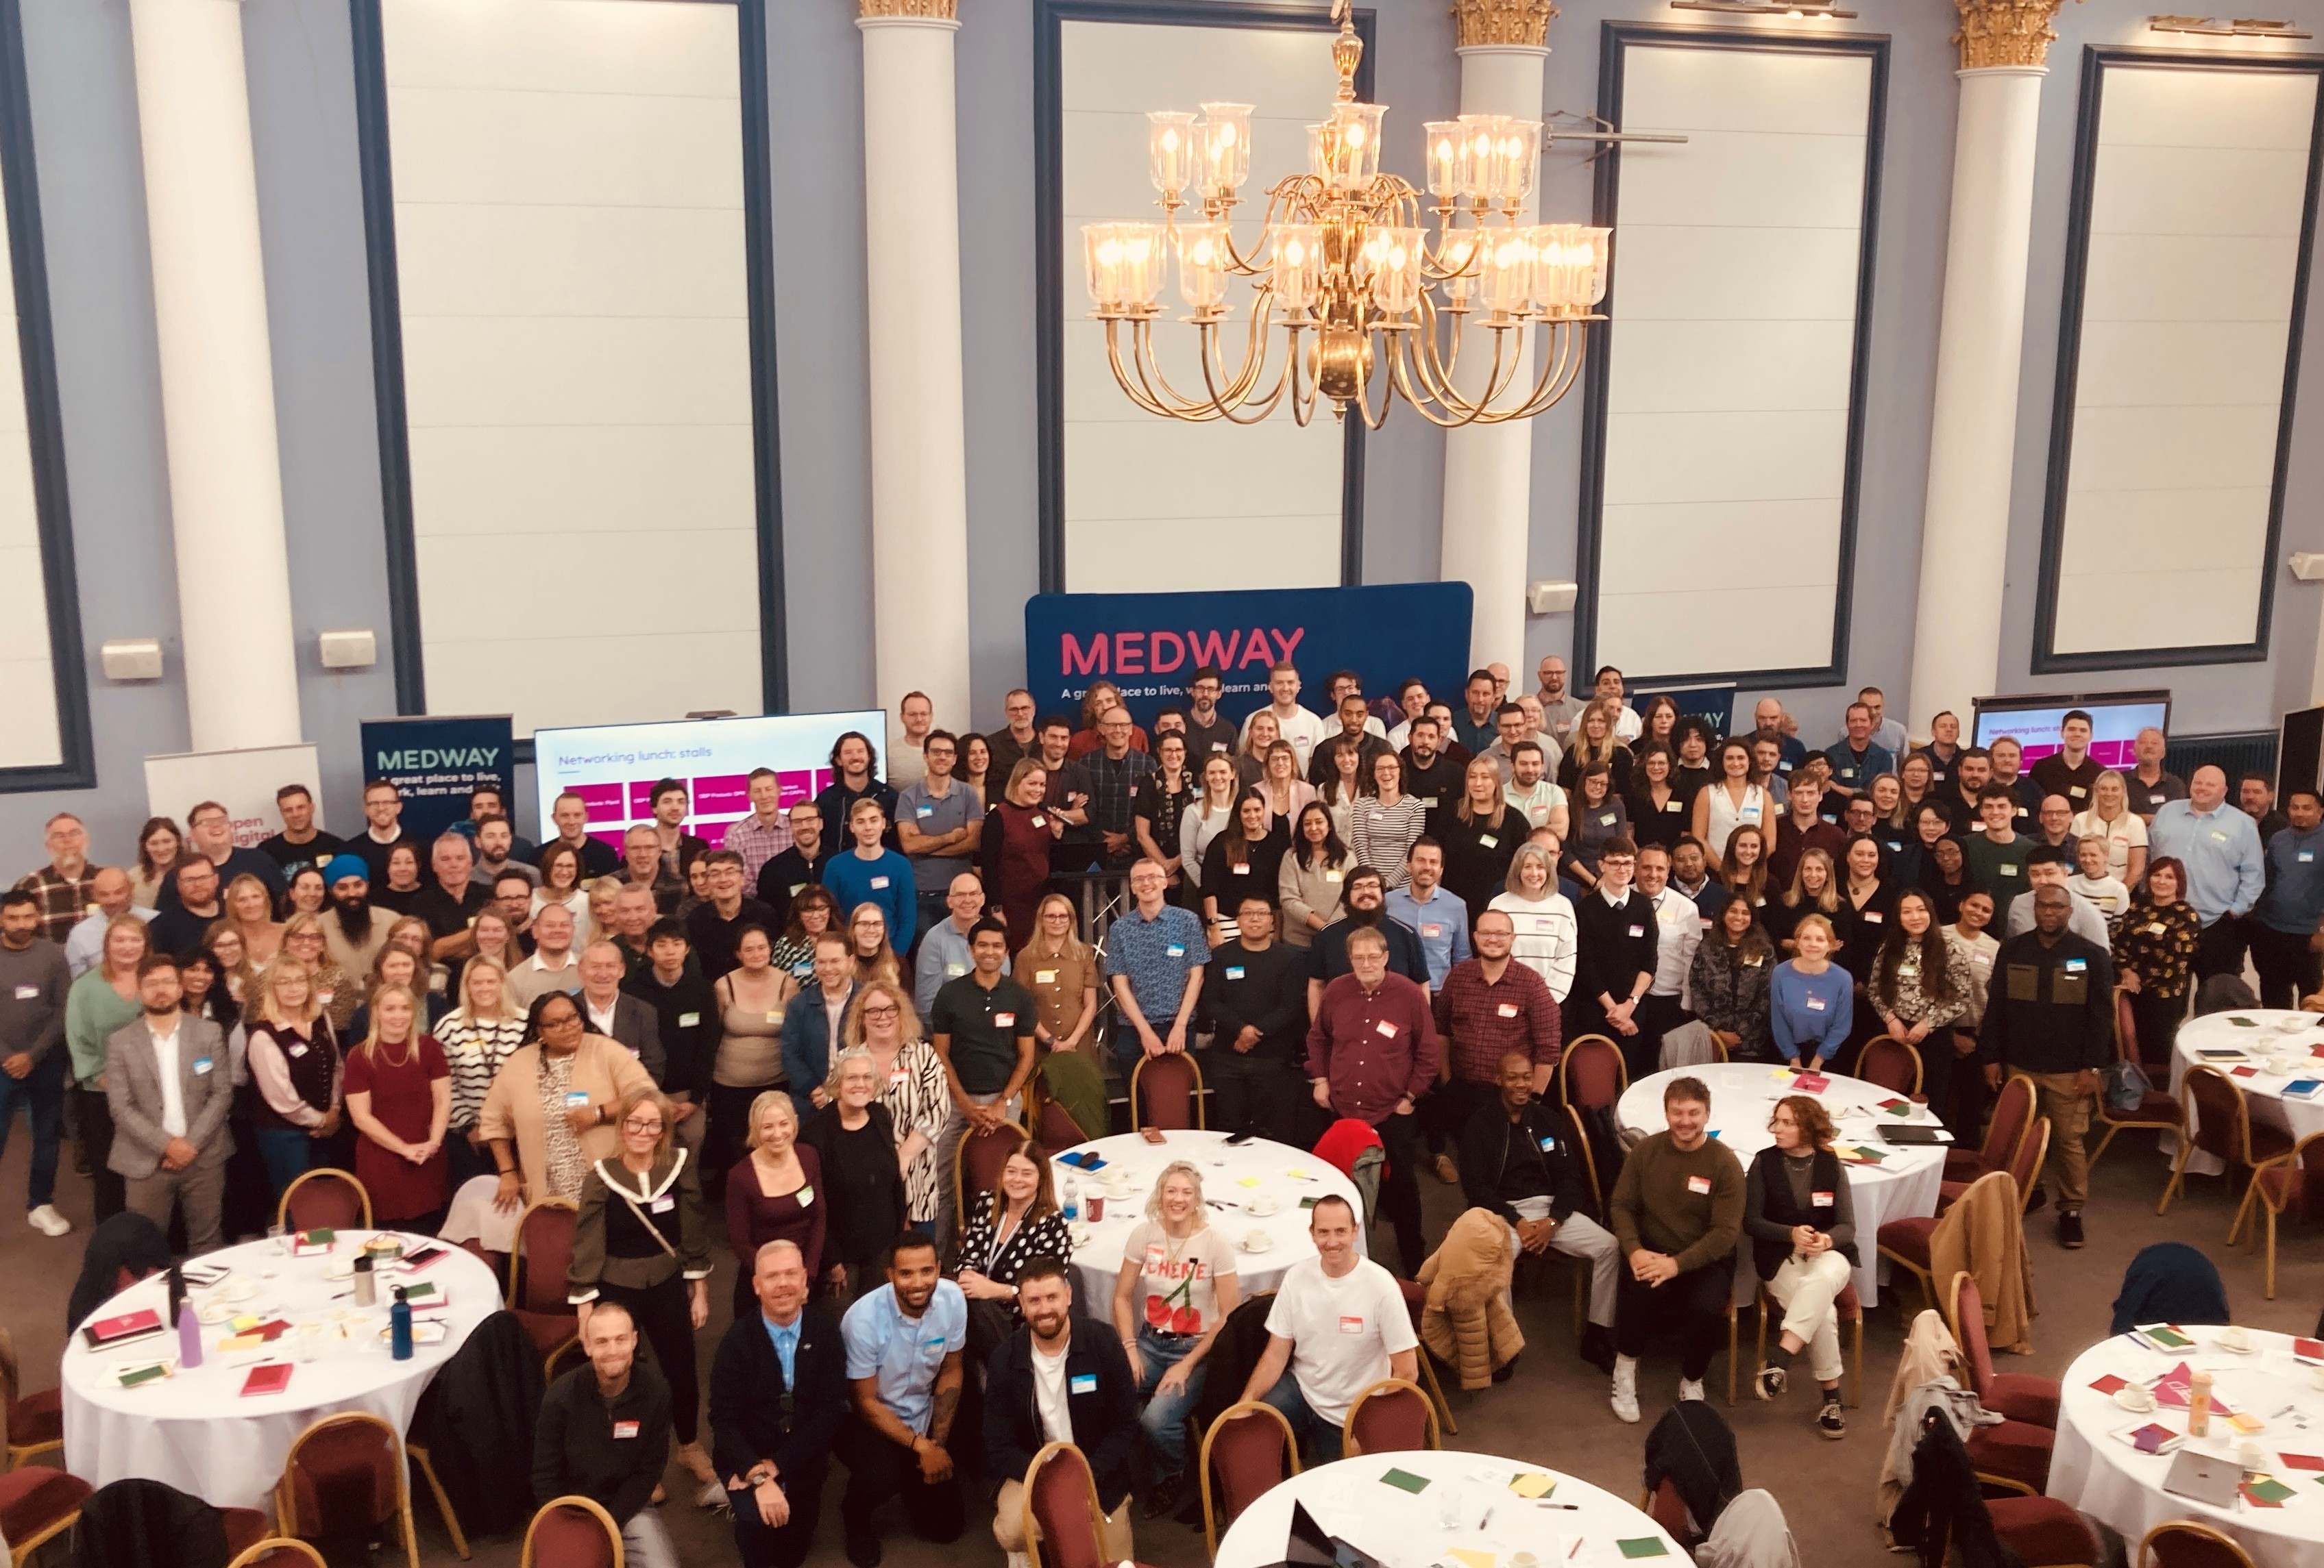
ODP General Meeting
2 February 2026

Slide 2
What's the purpose of this meeting?
When is it? Monthly, first Monday of the month
Who is it? Everyone involved in Open Digital Planning (over 223 LPAs, delivery partners and the MHCLG team)
What is it for? It's our opportunity to give updates, share opportunities, showcase some of the work happening in the community, and (sometimes) bring in speakers from elsewhere that are relevant to the work we do
Is it recorded? No, but we do add the slides to the ODP hub
Notes:
Read words on slide
Don’t forget to introduce yourself Tom!

Slide 3
Agenda
Data drop in Lean Coffee Hijack: Mike
Newcastle Policy Monitoring: Samantha
Local Plan maker support wanted: Caryl & Niall
GMCA & GLA data hub: Emma
Spring event: Josh
L&D update: Phil
Notes:
Tom

Slide 4
Data Drop in Hijack
Notes:
Phil

Slide 5
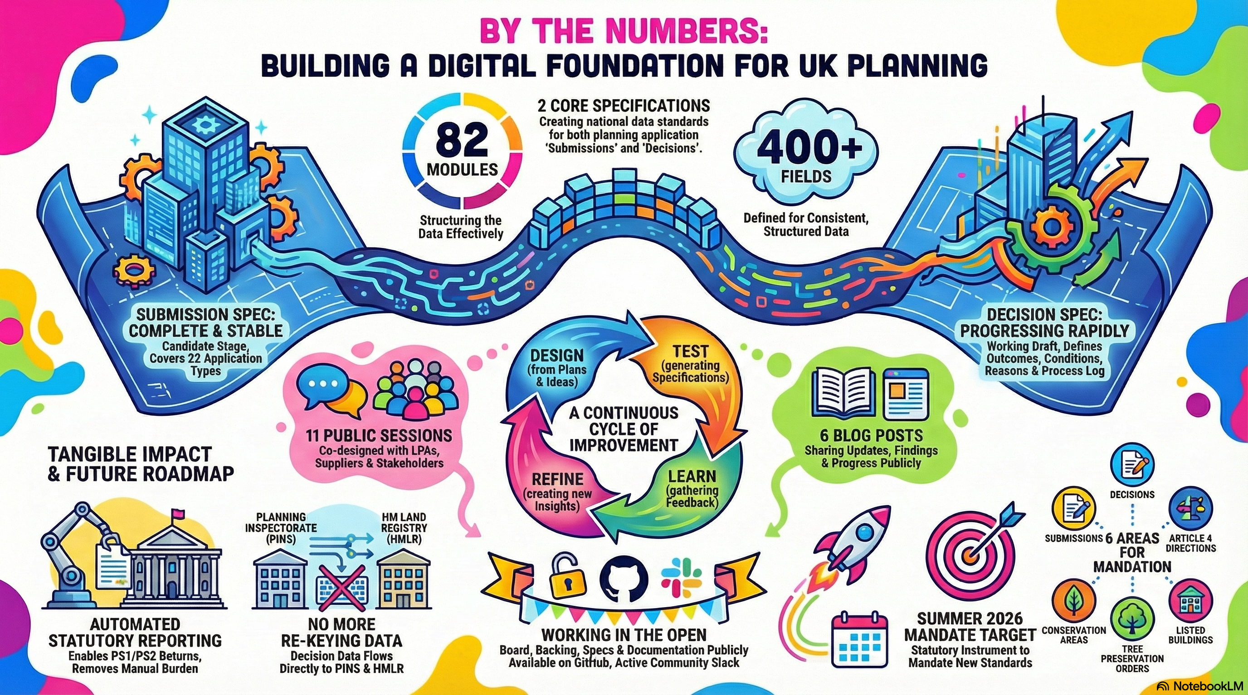

Slide 6
Lean Coffee
The session is run as a Lean Coffee to allow us to focus on topics and issues that are of most importance to you, rather than reacting to a pre-set list from us.
Topics are grouped and time-boxed, with the group voting on what gets discussed first.
This allows the session to flex depending on what you want to talk about, e.g. schema design, operational pain, governance, tooling, or delivery constraints.
Notes:
Phil

Slide 7
Intended outcomes
What data design wants to get out of it
A clear picture of what people are concerned about in terms of transition before data becomes a formal standard.
Insight into how providers and LAs are currently working with data in practice.
Evidence of what might genuinely block progress versus what is uncertainty or lack of clarity.
A shared understanding of what “good enough for now” looks like
Notes:
Phil

Slide 8
This will be an open session
We want to hear from anyone and everyone who has a view
Please forward on the invite to the session
We will be gathering information and reporting back in next ODSC meeting
  25 February 1030 -1200

Slide 9
Newcastle : Policy Monitoring Improvement
Notes:
If of interest please put your name down. Samatha and Thomas

Slide 10
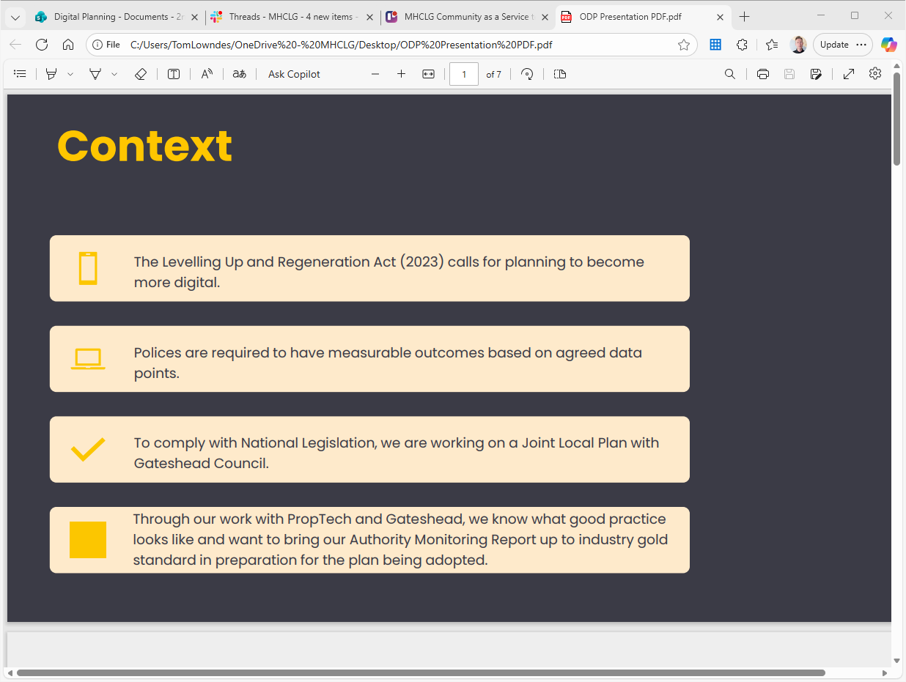

Slide 11
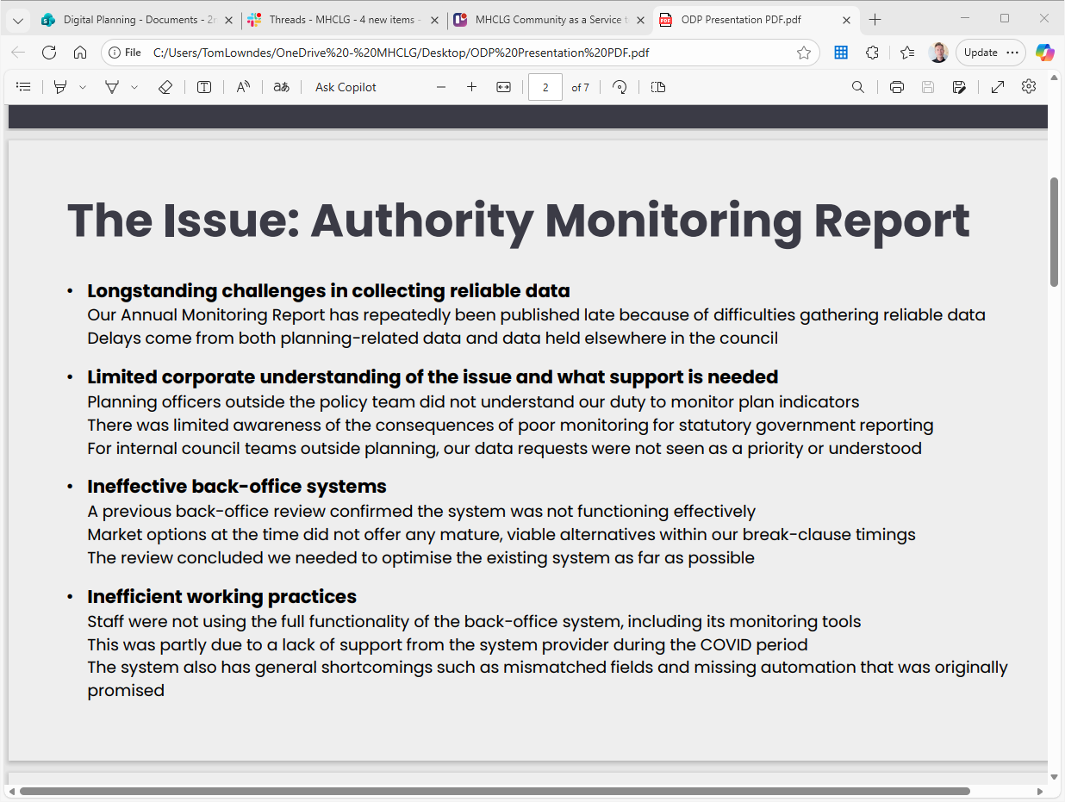

Slide 12
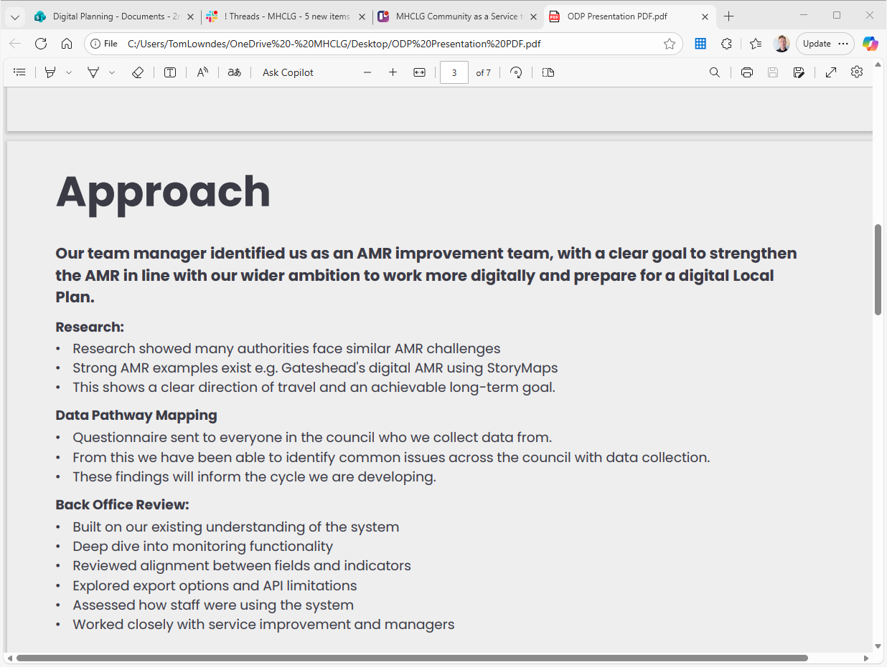

Slide 13
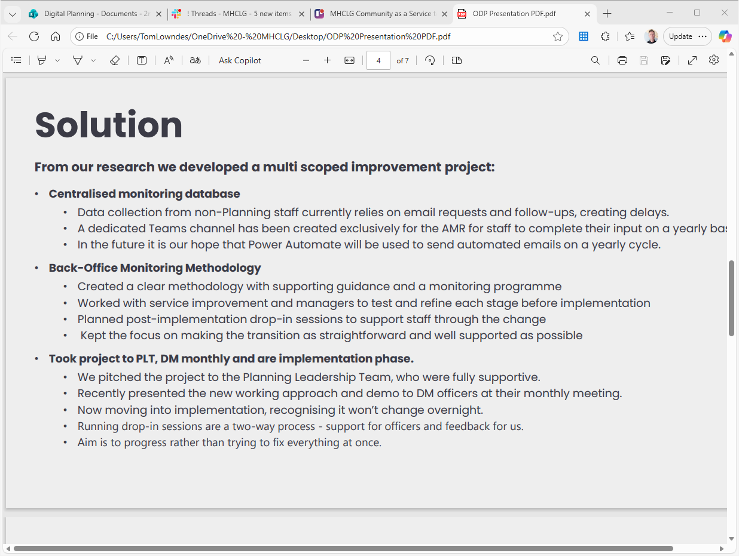

Slide 14
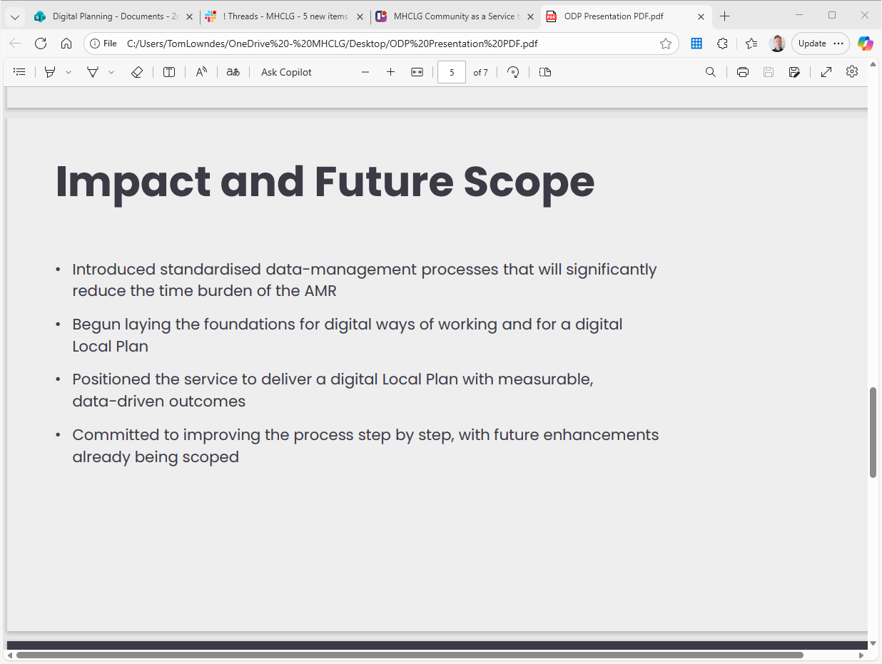

Slide 15
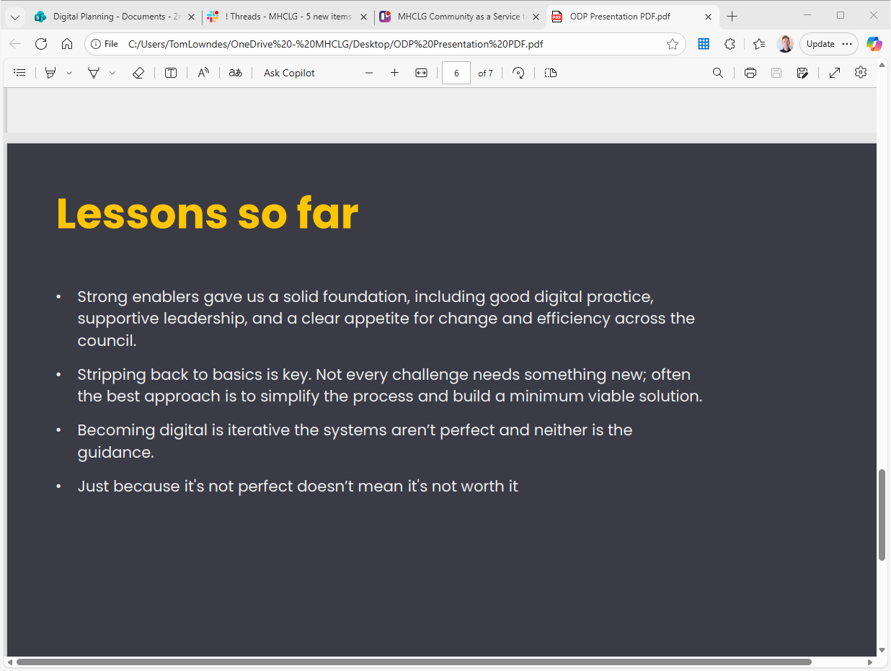

Slide 16
Model local plans project
Notes:
Caryl and Nial

Slide 17
Model local plans
The Model Local Plan project aims to define a model which outlines the core structure, components, and policies of a modern, effective local plan.
We’ve been working on this using a co-design process, involving several volunteer LPAs, PINs and MHCLG folk.
The co-design process has led us to believe that a series of light-touch templates and.guidance, for key sections of the local plan,. with sound examples, is a good MVP version of the model plan.
We have created these templates through a co-design process and are now preparing to user test with a view to launch some or all the templates by the end of March this year.
Notes:
Niall

Slide 18
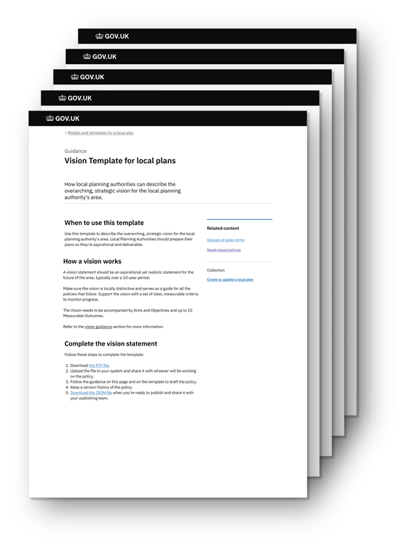
Templates
There are five templates in the model local plan which together outline the core components of a modern, effective local plan. These are:
  vision
  monitoring
  spatial strategy
  site allocations
  locally distinctive policies
In addition to these we will also be testing guidance on the key diagram.

Slide 19

Outcomes
If it’s working, the model plan should support with…
Simple.
Helping to make plan-making and assessment simpler and faster with streamlined, clearly written policies and content.
Confident.
Providing a clear direction LPAs can be confident in taking when plan-making, knowing the plan will be the right-size and likely to be deemed sound by PINs.
Digital.
Serve as a solid foundation for the development of fully digital local plans which are interoperable with planning data standards.

Slide 20
Next steps
We’re kicking off user testing of the model plans, starting with a demonstration of the model plan followed by a quantitative survey.
We’re using the survey to validate the co‑design outputs and identify opportunities to refine the templates and example plans.
We’re also starting deep dive user testing of the five templates with a new group of ~6 LPAs over the next two weeks.
We’re submitting the completed templates to PINS, who will review them for soundness and assess whether the format and guidance support LPAs in successfully submitting their plans.
Notes:
Phil

Slide 21
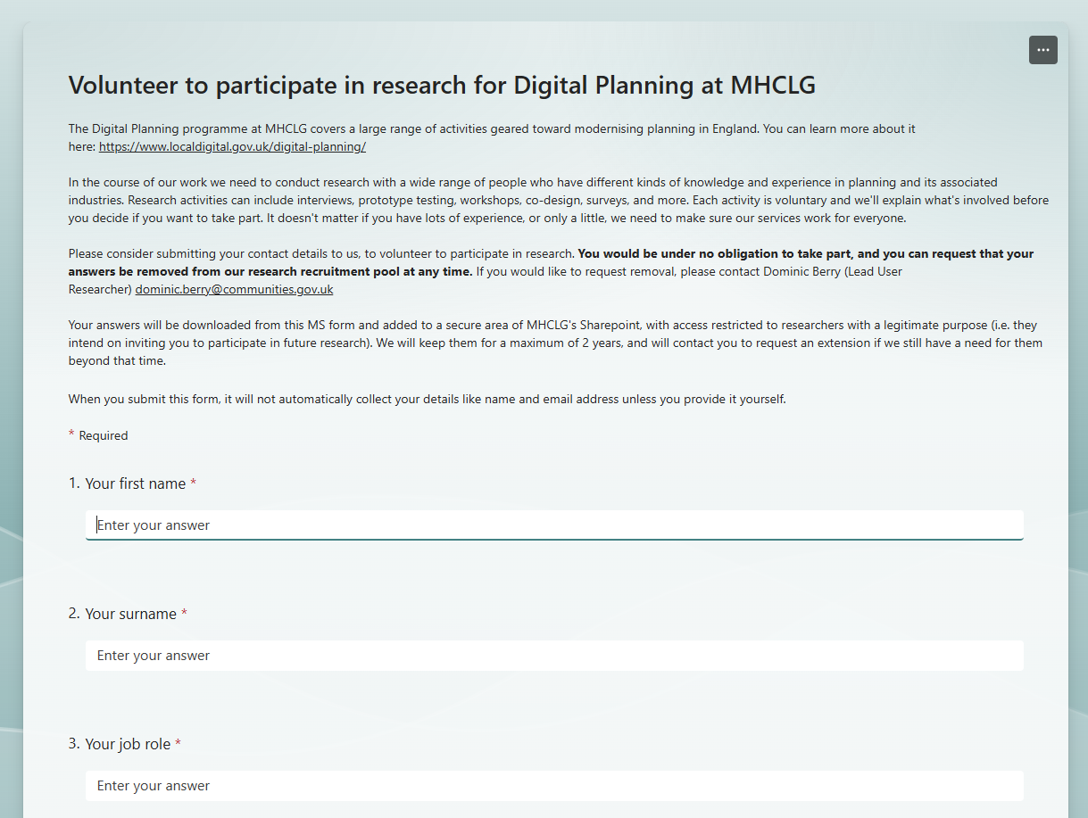
How you can support user research
  For those who have already signed up for cross-programme user research, a select number of you may be contacted to support this research through our usual recruitment process in the next week or so
  If you have a particular interest in the model plans work, or know someone who would be interested, please contact me via email or Slack.
  If you can support our user research, please complete the expression of interest form. Your details will be stored securely, and we track participation to ensure no one is contacted too frequently. This protects your time and helps us avoid testing bias by ensuring we hear from a diverse mix of users rather than the same voices repeatedly.
Notes:
Phil

Slide 22
Strategic Project update: GMCA
Notes:
Emma & Lucy

Slide 23
Strategic Projects
City of London Council – Digital Local Plan
Nikki Webber
Greater Manchester Combined Authority (GMCA) & Greater London Authority (GLA) - Planning Data Hub (discovery)
Emma Poolan
Lambeth Council – Building Control: Improving the System (alpha)
Catherine Neal
Notes:
Phil

Slide 24
GMCA X GLA
ODP Strategic Project
Emma Poolan, GMCA
Principal, Planning and Housing
Research Programme Manager – Digital Planning
emma.poolan@greatermanchester-ca.gov.uk

Slide 25

GMCA X GLA Strategic Project Overview
A collaboration between the Greater Manchester combined authority and the Mayor of London to deliver a discovery on how to monitor, visualise and report planning data in the built environment.
Building on experience from the Planning London Datahub to explore whether similar principles can work outside of London
Delivering a project through establishing a collaborative working relationship with multiple tiers of local authorities in both cities, planning back-office system providers and the built environment technology sector.

Slide 26
Project Objectives
Exploration of current Greater Manchester approach to monitoring development sites through the planning system​
Pilot the application of London planning data hub to Greater Manchester as a tool to monitor development across Greater Manchester
Develop an understanding of how a shared platform for collecting and sharing data might work​
Build an understanding of how the built environment sector can engage better with development data to deliver quality outputs ​
Develop recommendations for how the built environment data work can scale including an initial business case for this work

Slide 27



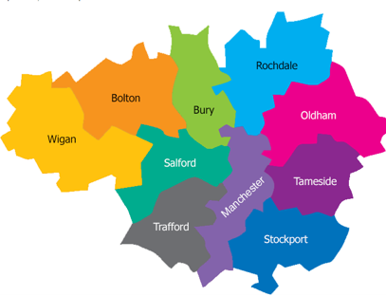



Local Authorities
ODP Strategic Project
Delivering a MHCLG funded discovery project through collaborative working, building on experience from Planning London Data Hub, testing applicability beyond London.
GMCA
GLA
Planning Portal and Back Office Providers
Build a connector for a database (Atkins)
ODP Development Management Software Fund
Pilot Adopters
Salford
Dorset
Redbridge
Leeds
Hounslow
Strategic GM Project & Pilot adopter's link
Risk without co-ordination

Slide 28
Our task
90% of application information
Planning Portal
Back Office Providers
Atkins
GMCA
Application
10% of application information
Visualisation
1 Connector per back-office provider
Elasticsearch database
JSON Connectors

Slide 29
Prepare the LAs and Back Office Systems for the connectors
Summer 2025
Awarded funding and resourced Programme Manager
Engage with Atkins (database provider)
Host breakout sessions at the ODP Winter Event
2026
Engaged with all 10 GM Local Authorities, Back Office Providers and Planning portal
April – June 2025
Develop a scope for the project
Procurement and go live of connectors
Review and assessment
Winter 2025
Co-ordinate with MHCLG National Data Standards Project to ensure projects were aligned
Data reporting and visualisation

Slide 30
Strategic and business user cases
“What is the pipeline of affordable homes over the next 5 years?”
“Which developers are developing schemes across the city region and to what volume?”
“How many stalled sites are there and who are the developers with stalled sites?”
Bring together planning application data across GM into a single data set, where we can see the life cycle of an application in the planning system seeing a pipeline view rather than a retrospective snapshot
Cross-boundary analysis, which is currently difficult without coordination or shared data across local authorities

Slide 31




Future use
How Planners can play a more impactful role in producing data through using their back-office systems to host and manage data
A better understanding of the business case for standardised data in the built environment
Recommendations for improvements on the robustness of a Data Hubs Infrastructure
A deeper understanding of how built environment professionals can engage with the process of producing data to a standard

Slide 32
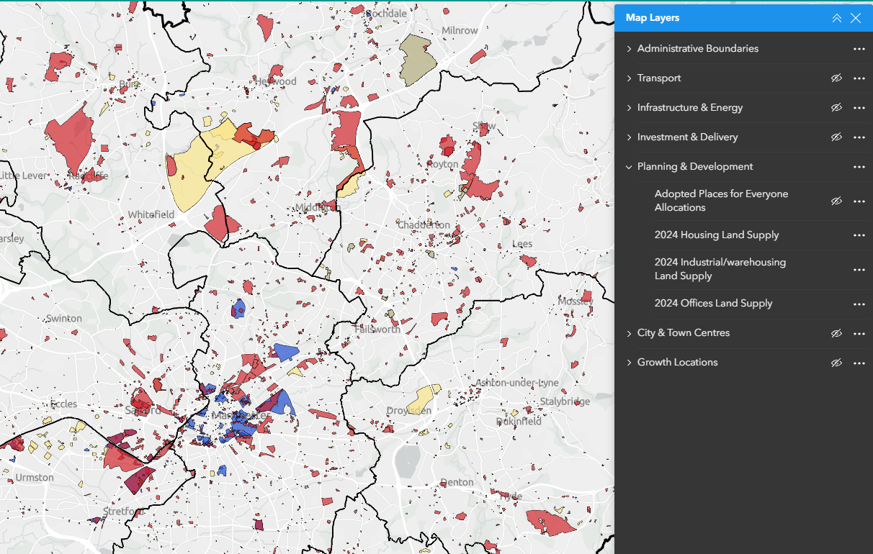
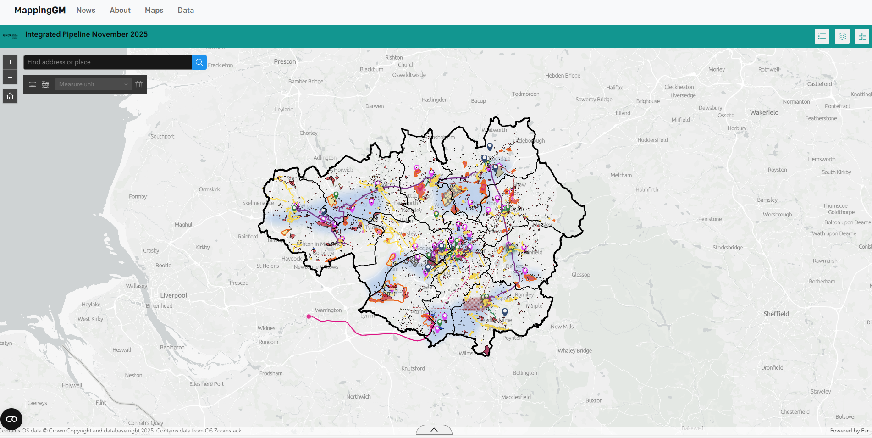
Integration into current GMCA work
The GM Integrated Pipeline sets out the infrastructure and physical development needed to deliver GM’s growth ambition over the next 10 years.

Slide 33
Thank you
emma.poolan@greatermanchester-ca.gov.uk

Slide 34
Spring event: Lake District National Park Authority (Josh)
Notes:
Sign up shout out, Josh?

Slide 35

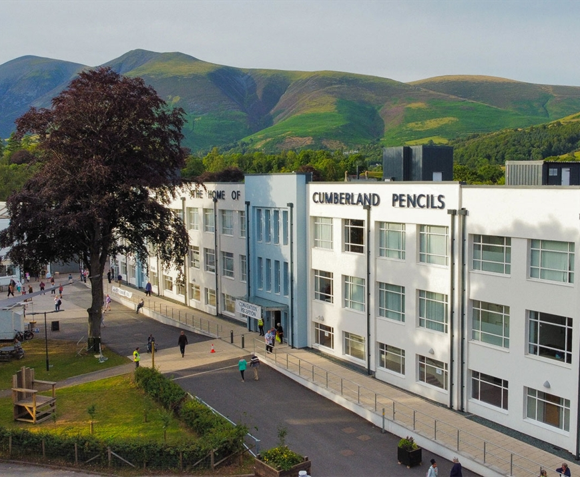

Lake District National Park Authority - Keswick
We’re excited to bring the Open Digital Planning community together for our next away day, hosted by the brilliant Lake District National Park Authority on Thursday 26th March 2026, 10am – 4pm.
Nestled in one of the UK’s most stunning landscapes, where tranquil lakes meet dramatic fells, this gathering will be a chance to step out of the everyday and into a space of fresh ideas, collaboration, and inspiration.
Venue: The Pencil Factory, Carding Mill Lane, Keswick, CA12 5NG.
Notes:
Josh

Slide 36
Learning and Development (Phil)
Notes:
Sign up shout out, Josh?

Slide 37
L&D
Final L&D 101 session of the current series on Wednesay 4 Feb - Procurement 11:30 to 12:30
(send us aSslack message if you need the invite)
GIS courses for Feb are live and links to register were posted in LPA General
Clean Your Data – 5th February
Publish your Data – 10th February
Geospatical Basics – 19th February
Intermediate QGIS Training – 26th February
Agile 101 being finalised for March in Newcastle
Notes:
Phil

Slide 38
Tell your story!
We'd like to continue LPA showcase slots at future General Meetings
If you'd like to take a 10 minute showcase slot, please get in touch with Tom
Showcases are the same short story-telling moments we have at our in-person events, opportunities to hear from the range of LPAs in ODP and all the interesting work happening!
Notes:
Tom

Slide 39
Thank you!
#all-lpa-general

