Slide 1



GLA and GMCA Collaboration: Piloting the Planning London Data Hub in Greater Manchester
Simon Long, simon.long@london.gov.uk , GLA
Emma Poolan, Emma.Poolan@greatermanchester-ca.gov.uk , GMCA
Lucy Woodbine, lucy.woodbine@greatermanchester-ca.gov.uk , GMCA

Slide 2



GMCA/GLA 2025/26 Strategic Project Overview
A collaboration between the Greater Manchester combined authority and the Mayor of London to deliver a discovery on how to monitor, visualise and report planning data in the built environment.
Building on experience from the Planning London Datahub to explore whether similar principles can work outside of London
Delivering a project through establishing a collaborative working relationship with multiple tiers of local authorities in both cities, planning back-office system providers and the built environment technology sector.
Funding from ODP for 2025/26.
Notes:
LW

Slide 3
Project objectives
Exploration of current Greater Manchester approach to monitoring development sites through the planning system.
Pilot the application of London planning data hub to Greater Manchester as a tool to monitor development across Greater Manchester.
Develop an understanding of how a shared platform for collecting and sharing data might work
Build an understanding of how the built environment sector can engage better with development data to deliver quality outputs
Develop recommendations for how the built environment data work can scale including an initial business case for this work
Notes:
LW

Slide 4
Strategic and business need
How Planners can play a more impactful role in producing data through using their back-office systems to host and manage data
A better understanding of the business case for standardised data in the built environment
A deeper understanding of how built environment professionals can engage with the process of producing data to a standard
Recommendations for improvements on the robustness of the Data Hubs Infrastructure
“What is the pipeline of affordable homes over the next 5 years?”
“Which developers are developing schemes across the conurbation and to what volume?”
“How many stalled sites are there and who are the developers with stalled sites?”
Notes:
LW

Slide 5


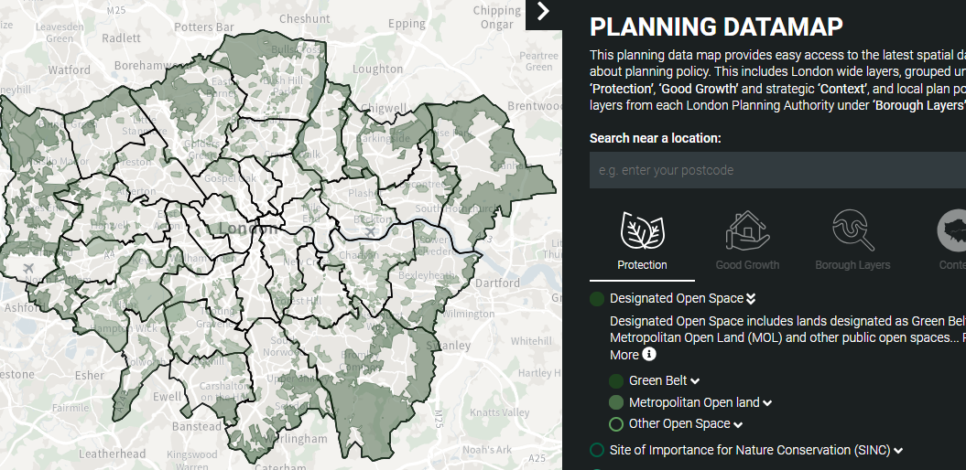
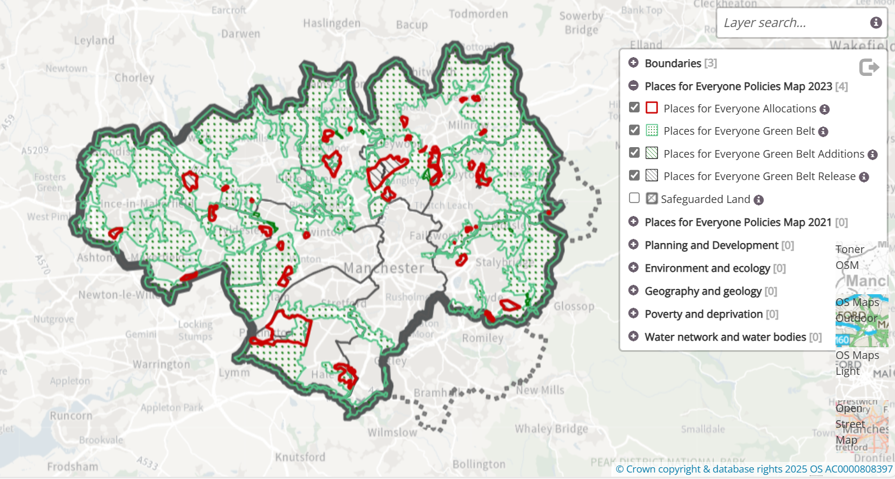


Why Greater Manchester and Greater London?
Both strategic authorities have a history of innovation and collaboration in digital planning in both cities which provides buy in locally.
Greater Manchester provides an opportunity to test whether a system developed in London can expand – testing the appetite of local authorities, back-office providers and the built environment.
There is an increased pressure on both authorities to report on and monitor performance in the planning and development process making the need for data core to the work that both organisations do.
Greater Manchester is an area with a joint plan of 9 local authorities and 1 Local Authority with a separate plan, whereas London has an SDS and 34 authorities. All of these require monitoring. The combination of these different frameworks represents the different structures that might be available under devolution.
Greater Manchester is in the early stages of developing a GM strategic development plan.
Notes:
PK

Slide 6


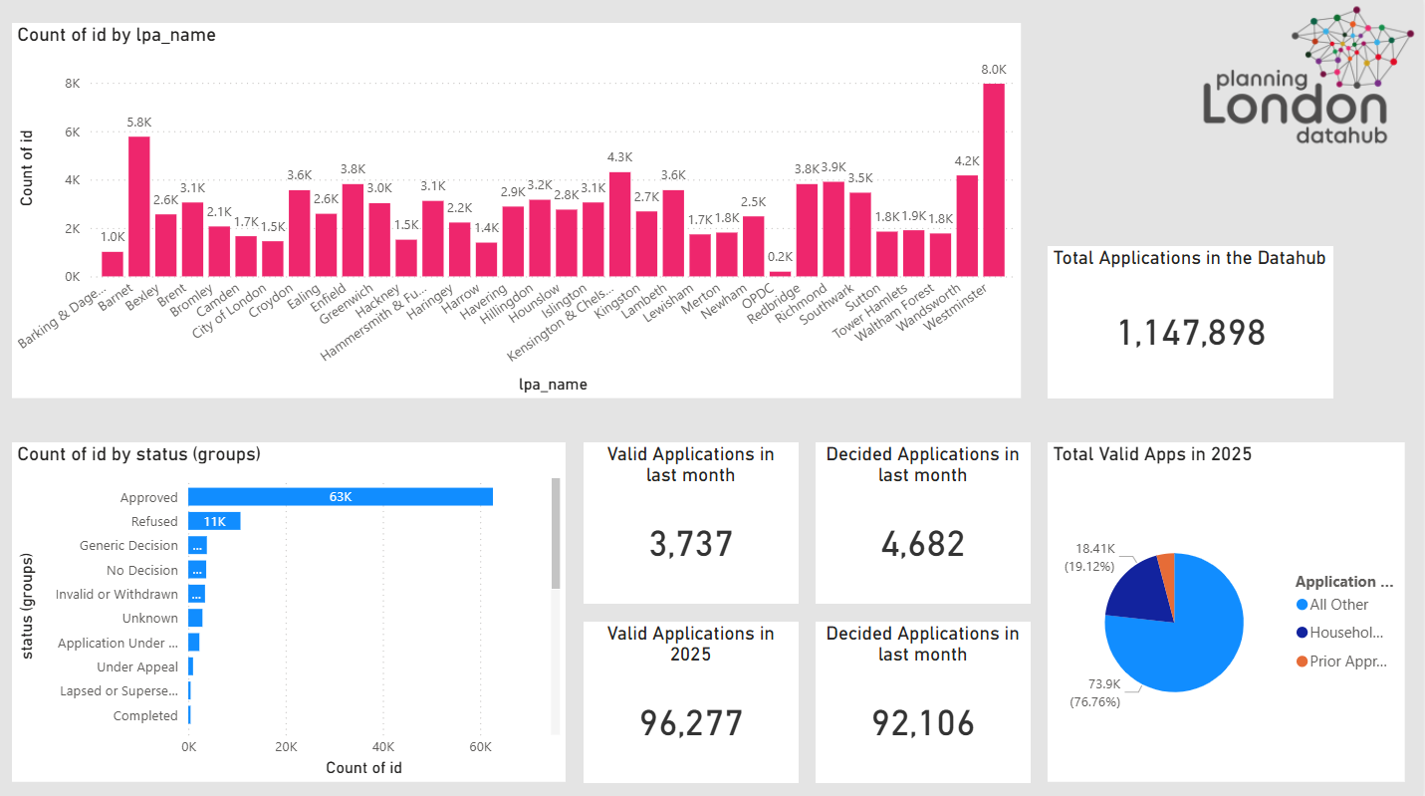
WHAT IS THE PLANNING LONDON
DATAHUB (PLD)?
Digital Twin of the Planning system in London
Funded Initially with £100k by MHCLG and £400k by Mayor of London
Holds data on 1.1 million planning applications
Has three core features that’s key to how it works
  New ‘GLA’ questions added to Planning Portal Application forms
  Automated feeds to collect data from all 34 back-office systems in London and data submitted by applicants (via planning portal)
  The data is code mapped to standardise key information

Slide 7
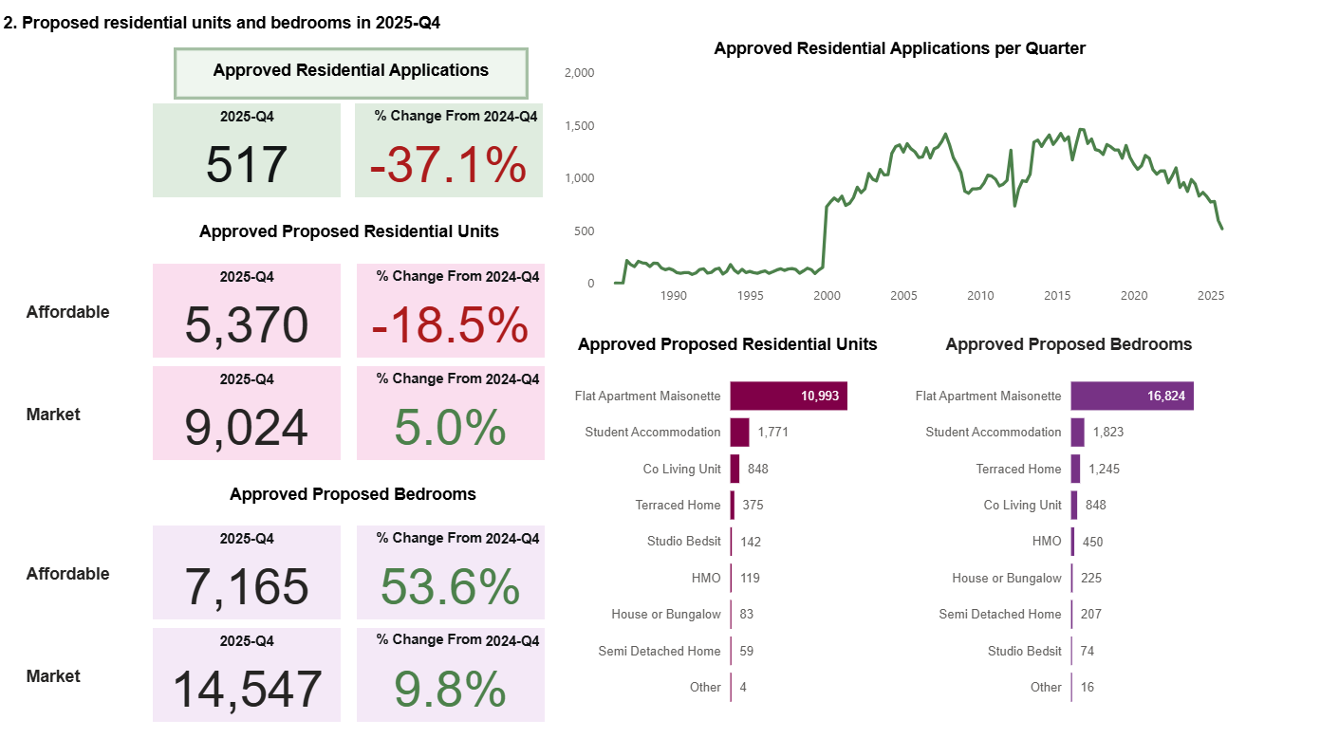
WHAT DATA DOES IT HOLD?
Data about the processing of the Application and Decisions
The following data is collected from back-office systems and transferred on a daily basis through APIs
Valid dates, decision dates, description, status, address information, appeals and polygon data etc
Data about the development
The following data is collected through the planning portal submission process from the applicant and merged with the data from back-office systems
Residential Unit information (unit type, no beds, tenure etc)
Other Residential (non-self contained accommodation)
Use Class Floorspace (types and areas)
Parking Space data
Open / Protected Space
Tall Building information
Infrastructure and environmental data

Slide 8
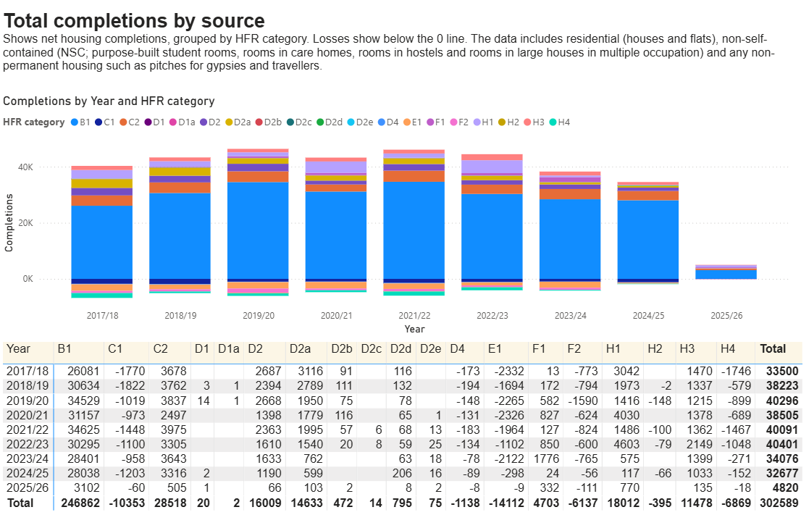
WHAT DATA DOES IT HOLD?
Data about the processing of the Application and Decisions
The following data is collected from back-office systems and transferred on a daily basis through APIs
Valid dates, decision dates, description, status, address information, appeals and polygon data etc
Data about the development
The following data is collected through the planning portal submission process from the applicant and merged with the data from back-office systems
Residential Unit information (unit type, no beds, tenure etc)
Other Residential (non-self contained accommodation)
Use Class Floorspace (types and areas)
Parking Space data
Open / Protected Space
Tall Building information
Infrastructure and environmental data
Monitoring Data
We also monitor every residential housing unit and every use class for start and completion dates

Slide 9
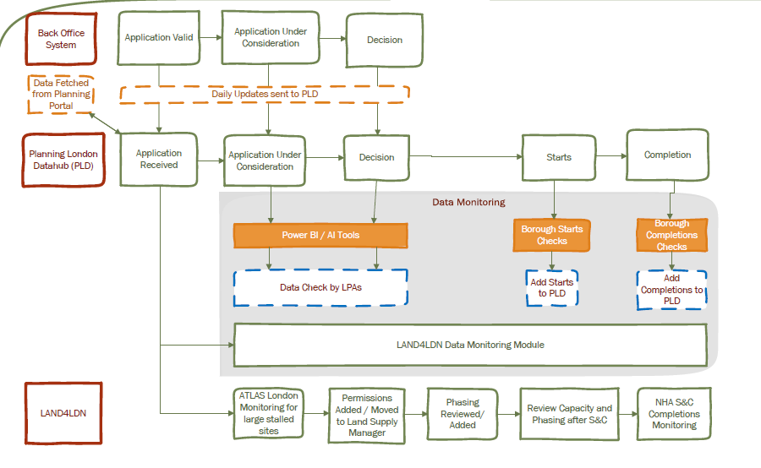
HOW IS THE DATA COLLECTED & UPDATED?
Data received from London Planning Authority back-office system
Data requested from Planning Portal and matched to record
Regular updates from BO systems from submission through to decision
LPA Data Officers update PLD for S&C dates, Power BI & other tools to help identify key sites to monitor
Going forwards BO systems will hold all GLA fields and all data will be managed through BO systems and sync’d with PLD
Sites also feed through to LAND4LDN for live digital SHLAA / ATLAS & NHA / Data Monitoring modules

Slide 10

HOW IS THE PLD USED?
Universities
TfL
FOIs
Developers to inform on future investments
Journalists
Housing Flow Reconciliation (HFR) Starts and Completions figures
Housing Delivery Test (HDT)
Referrable Applications
SHLAA Module
ATLAS / NHA Module
PLD Data Monitoring Module
Accessible Homes data used by Disabled Londoners. Data key to help find homes
Industrial Land Reviews
NHS
London Plan Monitoring
GLA Demography and City Modelling Team
Affordable Homes Programme
GLA Infrastructure Team (IMA)
Utilities Companies
Thames Water – 80% reduction in time spent researching planning apps
AI Decisions?
GLA Environment Teams
Planning Tech Startups

Slide 11
WHAT WE’VE ACHIEVED SINCE 2020
2020
2022
2024
First BO system to build GLA questions in their system (Uniform)
Online platform for Boroughs to login and edit data
First starts and completions to submit to MHCLG from PLD
launch of new website - planninglondondatahub.london.gov.uk
Launch of PLD
Creation of automatic Status flow logic
AI description checker to compare the description and data for resi units
2021
2023
2025

Slide 12
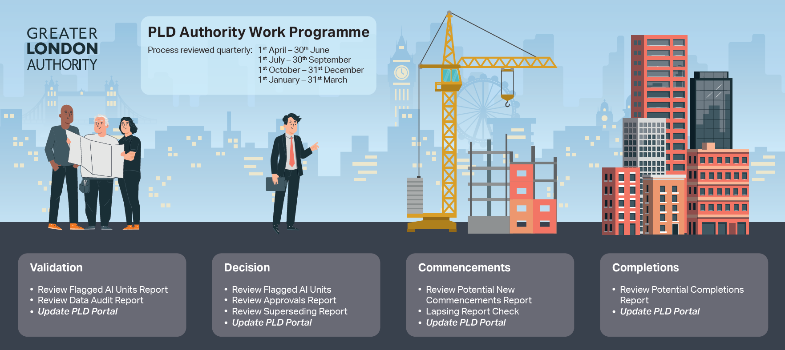
PLANS FOR 2026
Quarterly Data Review Framework
Current Annual Process > Quarterly Process
Traditionally London Planning Authorities focus on the annual Starts and Completions each year to update their data.
We are aiming to change this to a quarterly data review process
We are working with all LPAs to:
Provide updates on the four key stage
Building Additional software tools to help them
Building more Power BI reports
Updating documentation for them, which will also go on our website

Slide 13
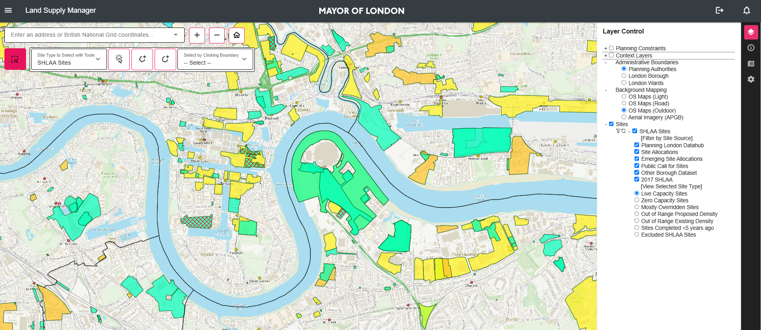

PLANS FOR 2026
Data Monitoring Module
Our LAND4LDN uses the PLD data to create a Live digital SHLAA.
We are aiming to build additional modules in that will allow users to visualise sites on a map and enable all 34 London Planning Authorities to monitor their sites in real time using external data sources

Slide 14
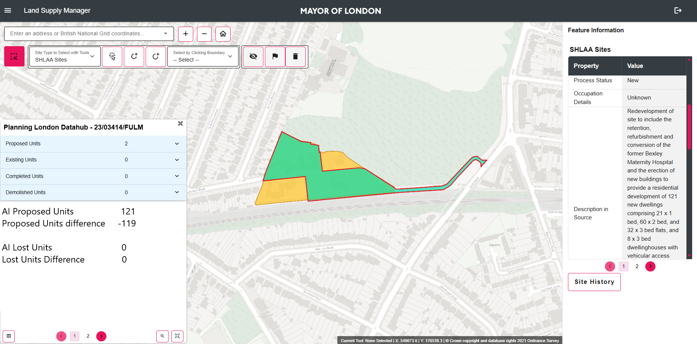
PLANS FOR 2026
Data Monitoring Module
We have created an OpenAI prompt to detect issues with our data.
Our first iteration has to check the description of the planning application for the numbers of units proposed/lost when an application has been approved and compare this with the data in our system.
We can then plot these on a map and allow users to work through all sites sequentially to ensure the data is accurate.
This process runs nightly to check for new approvals.

Slide 15
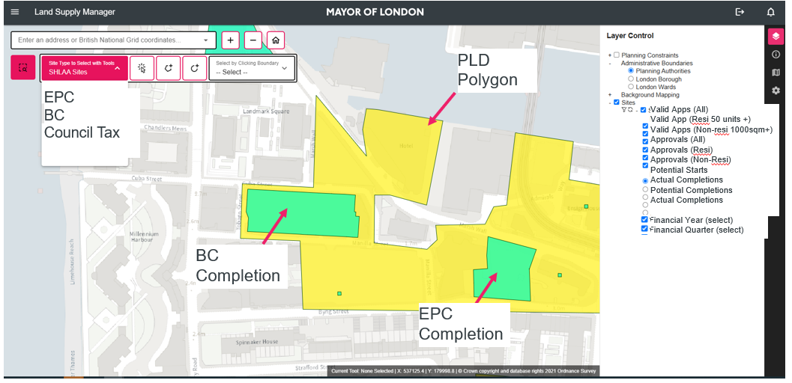
PLANS FOR 2026
Data Monitoring Module
Using external data sources we can also plot these on a map and overlap them with polygons of applications to indicate for potential starts and completions.
Users can then start or complete the relevant unit(s) in the PLD data, choosing whichever date they think is most accurate.
We will be trailing the following datasets:
  EPC
  Council Tax
  Building Control
  Street Naming and Numbering

Slide 16
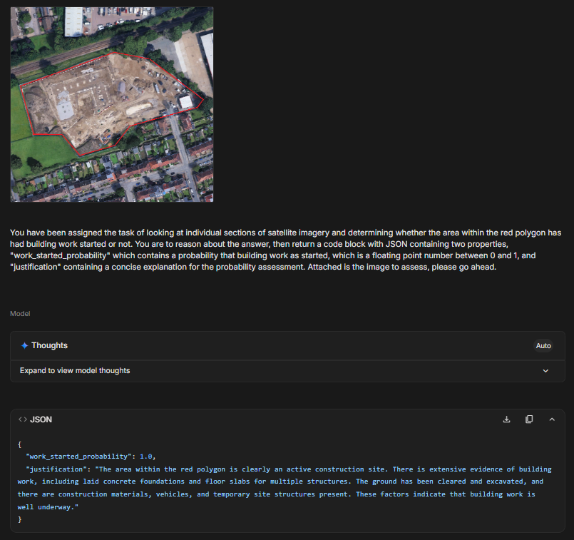
PLANS FOR 2026
Data Monitoring Module
The last element we are trialling for detecting Starts and Completion data is satellite imagery.
By using the polygon of the site and accessing the latest satellite data we can use Large Language Models to analyse if a site has start (or completed)
This initial trial was successful in interrupting that this site had started just by the red outline image alone.

Slide 17
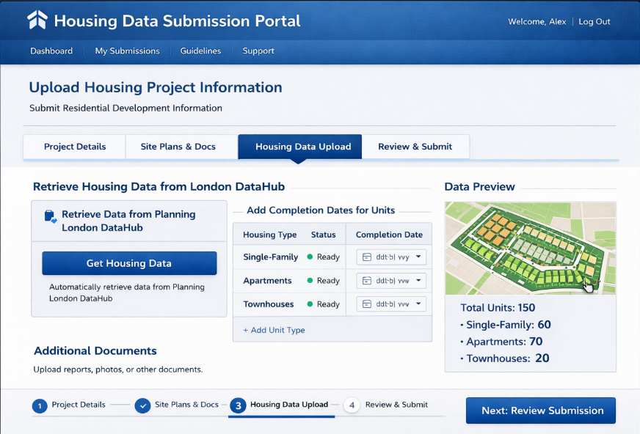
PLANS FOR 2026
Developer Portal
We are also looking to build a Developer Portal, enabling councils to contact developers for which units they have started/completed, using the PLD data directly
In its basic form this would look something like:
Council user emails developer with link to their ‘live’ sites
Developer views the data for application, including all unit information
Developer completes start and completion dates on units where applicable (and other data potentially
Data doesn’t automatically update system but requires council user to accept the change
Starts and Completions date is updated

Slide 18
Greater Manchester Combined Authority
Planning Pipeline Update

Slide 19




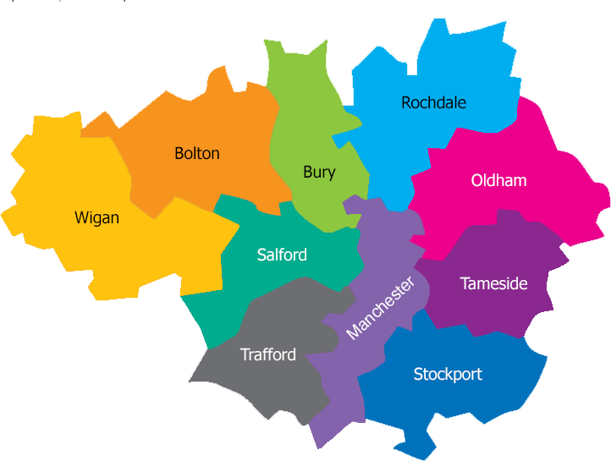



Local Authorities
ODP Strategic Project
Delivering a MHCLG funded discovery project through collaborative working, building on experience from Planning London Data Hub, testing applicability beyond London.
GMCA
Planning Portal and Back Office Providers
GLA
Build a connector for a database (Atkins)
ODP Development Management Software Fund
Pilot Adopters
Salford
Dorset
Redbridge
Leeds
Hounslow
Strategic GM Project & Pilot adopter's link
Risk without co-ordination
Notes:
This is the general flow that we’re trying to create via the data feed.

Slide 20
Our task
90% of application information
Planning Portal
Back Office Providers
Atkins
GMCA
Application
10% of application information
Visualisation
1 Connector per back-office provider
Elasticsearch database
JSON Connectors
Notes:
This is the general flow that we’re trying to create via the data feed.

Slide 21
Prepare the LAs and Back Office Systems for the connectors
Summer 2025
Awarded funding and resourced Programme Manager
Engage with Atkins (database provider)
Host breakout sessions at the ODP Winter Event
2026
Engaged with all 10 GM Local Authorities, Back Office Providers and Planning portal
April – June 2025
Develop a scope for the project
Procurement and go live of connectors
Review and assessment
Winter 2025
Co-ordinate with MHCLG National Data Standards Project to ensure projects were aligned
Data reporting and visualisation

Slide 22
Phase 1
Data Audit and Back Office System Review
Phase 2 - Digital readiness
June – September 2025
Engagement with the 10 GM Local Authorities
Co-ordinate with MHCLG National Data Standards Project to ensure projects were aligned
Identify and engage with the relevant GMCA Governance and Decision Maker boards
Engage with the Planning Portal and Back Office Providers
Agree the Scope of Work
August – December 2025
Prepare the LAs and Back Office Systems for the connectors
Engagement with Atkins (database provider)
Begin the procurement process between all parties
Host 2 breakout sessions at the ODP Winter Event
January 2026
Procure the connectors between the planning portal, relevant back office providers and Atkins
April – June 2025
Awarded funding and resourced Programme Manager
Preparatory work between the GMCA and GLA
Attend ODP Community Show & Tell
Phase 3
Collation of planning data in a digital platform
Phase 4
Data reporting and visualisation
Phase 5
Review and assessment
January 2026 +
Connectors go live
Work with Atkins to develop the database to receive and collate Greater Manchester Data and code map to a standardised format
Re-engage with the National Data Standards Project to ensure any of their actions will be compatible with our database
March 2026 +
May 2026 +

Slide 23
Options for next steps
Phase 5 only
GM Systems Only Rollout
National Testing and Rollout
Aspect | Details
Duration | 6 months
Lead | GMCA (MHCLG funded)
Purpose | Validate the system and gather evidence
Risk | After 6 months, there is no further project funding to continue the project
Aspect | Details
Duration | Ongoing
Lead | GMCA
Purpose | Local deployment and integration
Implications | Greater Manchester only development
Risk | Would need to source multi-year GMCA backing
Aspect | Details
Lead | MHCLG Partnership
Purpose | National standardised roll our of a planning data hub for all CAs or LPAs
Risk | Agree a funding approach

Slide 24
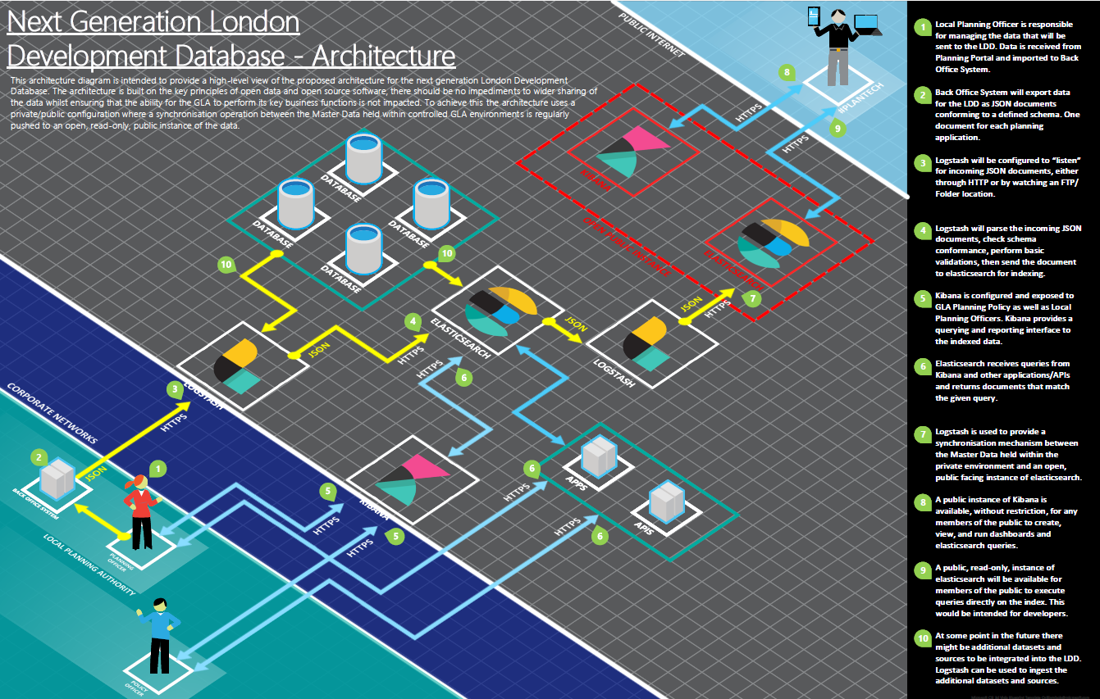
HOW THIS COULD BENEFIT OTHERS
Core Infrastructure and system code easily reused
Connectors built for all main suppliers (rollout would just require suppliers to install in each LPA)
Data can be ingested for any authority including those which don’t have the connectors installed day 1 (i.e. csv uploads)
Data submitted by the Applicant can be collected directly from Planning Portal in short term whilst LPAs upgrade their systems

Slide 25

HOW THIS COULD BENEFIT –
LOCAL AUTHORITIES
LA’s would benefit from collecting data from applicants in standardised formats
Data held in database, not spreadsheets on one person’s PC
Easily shareable / transparent for public
Standard reporting for all LPAs

Slide 26
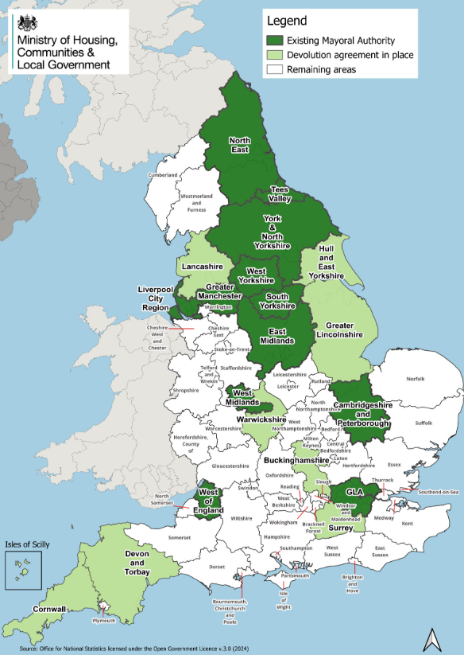
HOW THIS COULD BENEFIT –
COMBINED AUTHORITIES
Like London and Greater Manchester, combined authorities could monitor the impact of regional plans/policies
Collection of data easily and consistent
Would feed into processes like SHLAA’s
Could reuse the technology the GLA are building for S&Cs detection
North East Combined Authority also looking to do same as GMCA

Slide 27
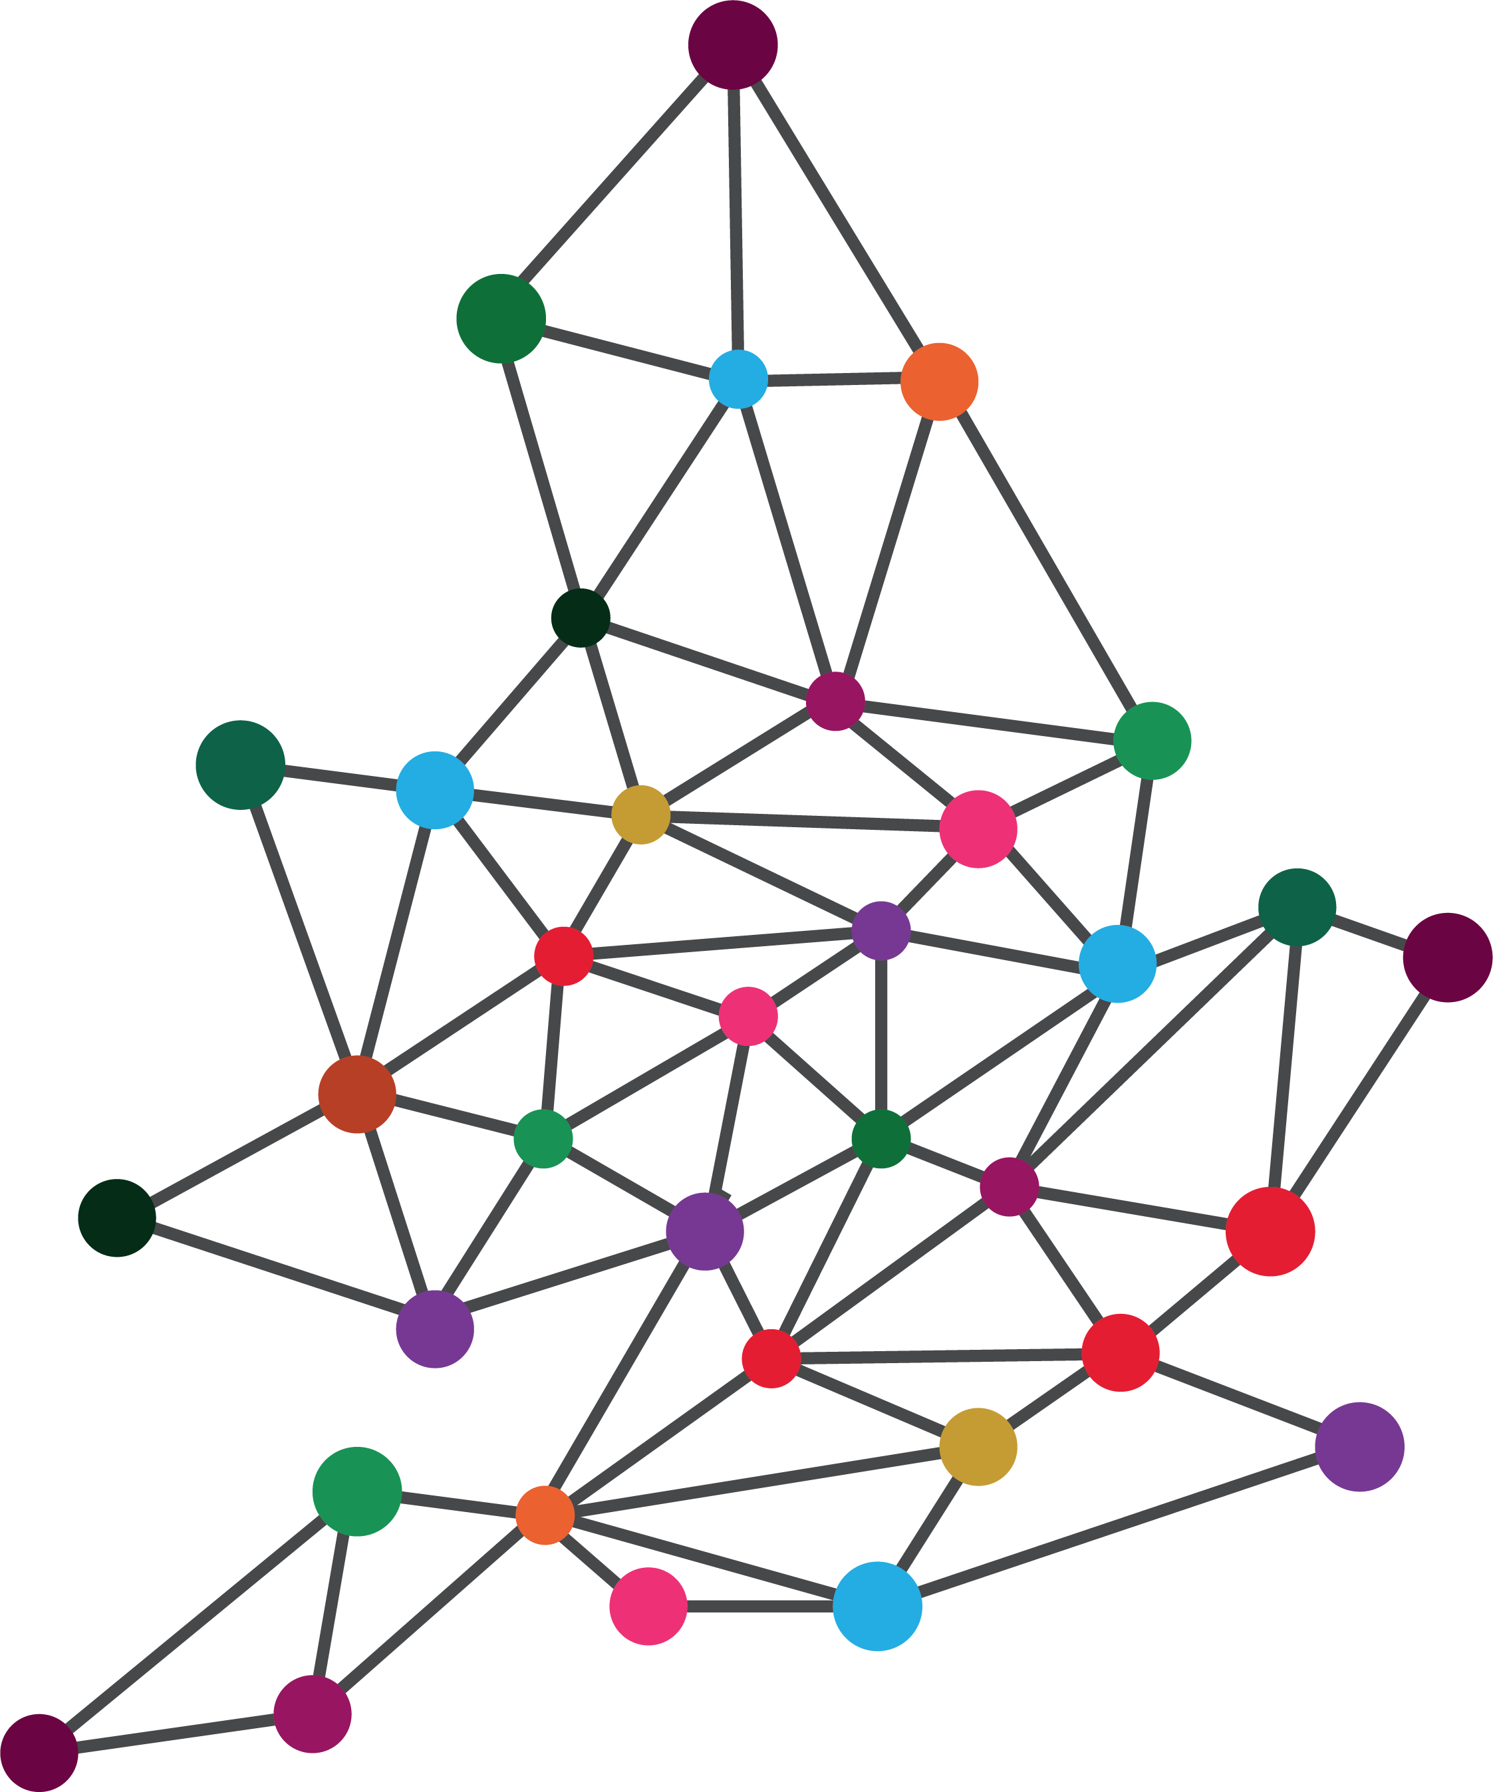



HOW THIS COULD BENEFIT –
MHCLG
Standard data schema that would provide – housing pipeline, starts and completions across the country
HFR completions figures could be collected automatically (and quarterly) on national scale
Information on the target of 1.5m homes would then be in a database, not council spreadsheets
AI work would also help spot those units not reported
Would integrate with national data standards work

Slide 28
HOW THIS COULD BENEFIT –
MHCLG
GLA Quarterly process / S&C detection functionality could be available to all to provide standard approach
Would need some development work to integrate with Plan X but not complicated to do
Could easily be integrated with planning.data.gov.uk – this data could be internal system which pushes public data to data platform
Could provide the data to help with future LLM models like the AI Decisions

