Slide 1
ODP General Meeting
2nd June 2025

Slide 3
What's the purpose of this meeting?
When is it? Monthly, first Monday of the month
Who is it? Everyone involved in Open Digital Planning (over 150 LPAs, delivery partners and the MHCLG team)
What is it for? It's our opportunity to give updates, share opportunities, showcase some of the work happening in the community, and (sometimes) bring in speakers from elsewhere that are relevant to the work we do
Is it recorded? No, but we do add the slides to the ODP hub

Slide 4
Agenda
Community update
  ODP hub
  Welcome events
Proptech Blueprints
Opportunities
  Learning and Development
  Geovation

Slide 5
Community update

Slide 6
ODP hub

Slide 7

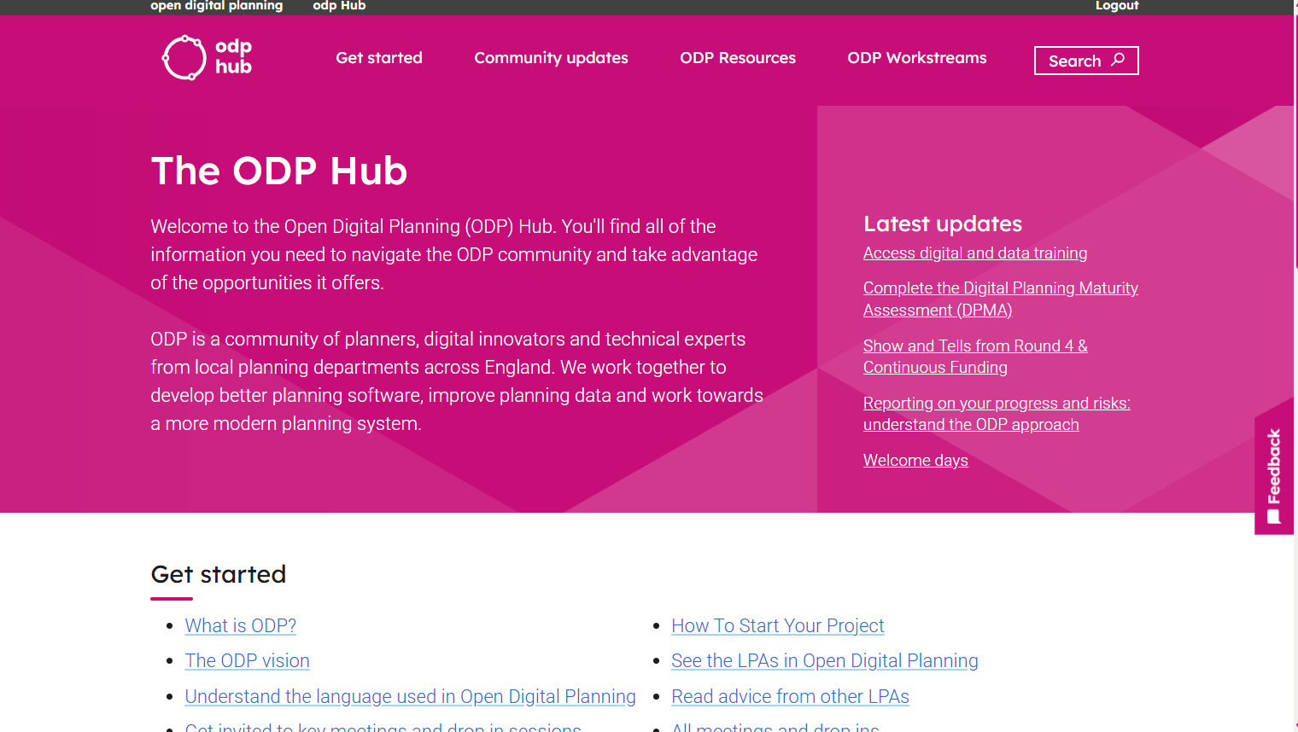
The ODP hub
Notes:
ODP Hub
Hello, I am Tom Lowndes, you may know from .........
Background
A quick recap on what the ODP hub is
It's an invitation only website where you'll find all the information you need to navigate the ODP community and take advantage of the opportunities it offers.
Designed to cover your onboarding journey to the community with content that relates to such profound questions as
What is ODP and What's our Vision and then all the way through to How to Start your project and how each of the meetings you may have been invited, can help you in your work.
Having just finished the new DPIF cohort 1-2-1s, it's a reminder to me that the work going on in the community can feel overwhelming, so this is a great place to take some time to see what's happened so far; and where we are heading.
Why are talking about changing the site?
Well the change of location was prompted by something I am sure you are all familiar with, an unexpected escalation in costs from the provider, in this case its Notion. After a quick overview of our options we plumped to adopt Drupal as our platform, some of you might be familiar with Drupal, its a free, open-source content management system and its something MHCLG, through the Local Digital Fund have supported for a number of the years.
We have kept the hierarchy with the migration and the process for access is the same, you make a request (fill out the form) and we add you to the user list.
Notion will be turned off online soon so best to get yourself logged in and feel free to send us feedback about what else you might want to see there.

Slide 8
ODP events

Slide 9
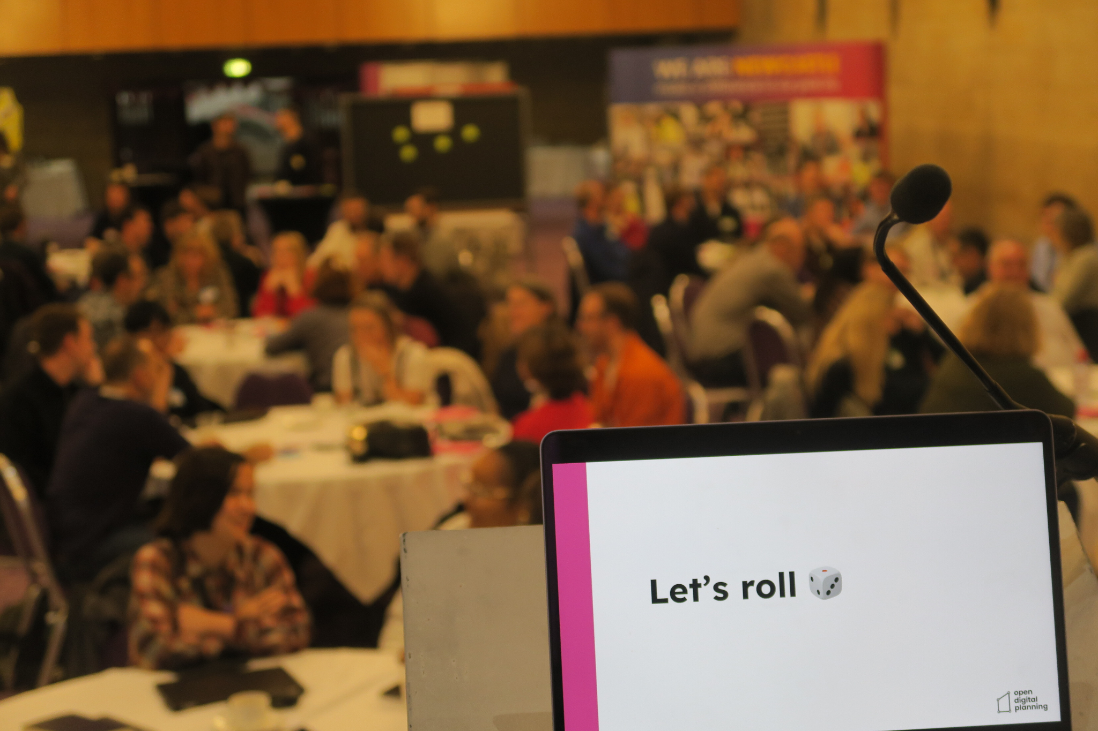

Slide 10
📆 Welcome events
Welcome events are open to all, but especially our brand new LPAs in the community
Strongly encourage that everyone attends one welcome event
You'll meet each other, find out more about ODP, and take part in activities that help define how we work and what we prioritise
You can use your funding to attend
10th June: London (Tower Hamlets)
24th June: Doncaster
Sign up here: https://forms.office.com/e/LE056pezPW

Slide 11
📆 Save the date!
16th July: ODP Summer event (Gloucester)
16th October: ODP Camp 2025 (Medway)
27th November: ODP Winter event (Lake District)

Slide 12
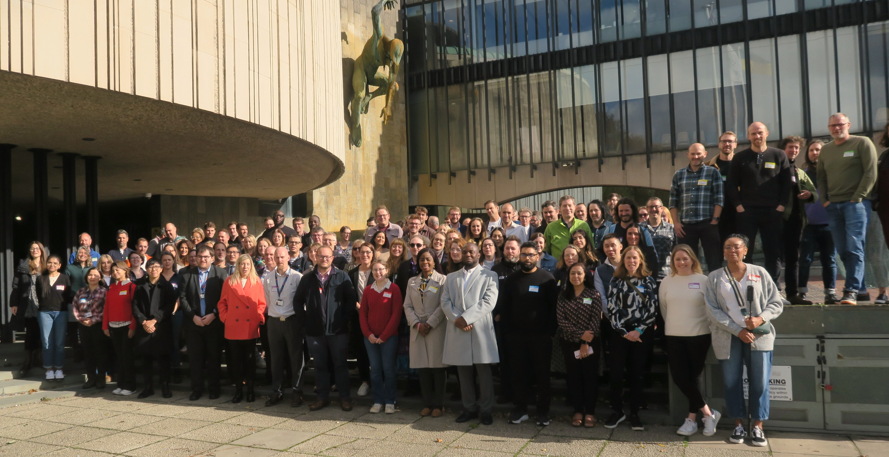
Notes:
Well am going to hand over to Chess now but I look forward to seeing you all soon at one our amazing community away days

Slide 13
PropTech Continuous Funding Blueprints
Notes:
Ben Duckworth

Slide 14
PropTech – Blueprints Update
What it is
We have created a shared blueprint template for Local Planning Authorities in PropTech Innovation Fund Round 4 Continuous Funding. This will help LPAs document their PropTech adoption journey in a structured, reusable way.
Notes:
Tom

Slide 15
PropTech – Blueprints Update
Why we’re doing it:
To capture valuable learning from across the funded projects in a consistent format.
To support LPAs in reflecting on what worked (and what didn’t) and what could be improved next time.
To build a library of real world examples for other authorities considering similar tools or approaches.
Notes:
Tom

Slide 16
PropTech – Blueprints Update
Benefits to the wider community:
A practical, peer-led knowledge base of digital planning implementation journeys.
Blueprint documents that help future LPAs save time, avoid known blockers, and learn from lived experience.
Greater visibility of the data, procurement, technical, and cultural components involved in adopting PropTech.
Insights that will inform future digital planning guidance, standards, and potential funding opportunities.
Notes:
Tom

Slide 17
PropTech – Blueprints Update
What’s included in the blueprint template:
Problem definition, supplier selection, team structure
Onboarding & cultural change
Data readiness, interoperability, and costs
ROI stories and lessons for long-term sustainability
.
Notes:
Tom

Slide 18
PropTech – Blueprints Update
Timelines:
✅ Template finalised: May 2025
📥 Submission window opens: June 2025
🗓️ Submission deadline: 19th December 2025
📚 Blueprints reviewed & shared: Early 2026 (Q1)
📣 Insights published to community: TBC
Next steps:
A downloadable Word version of the template will be provided on the new ODP hub with guidance
LPAs are encouraged to complete and submit by the deadline.
Optional visual, video or animated submissions are welcome to accompany your blueprint.
Notes:
Tom

Slide 19
Opportunities
Notes:
Ben Duckworth

Slide 20
Learning and Development
Notes:
Ben Duckworth

Slide 21
Learning and development
Sessions are continuing...
Series of online 101 introductory sessions that last 45mins – 1hr
Topics align with the different categories of the Digital Planning Maturity Assessment
They will take place on Wednesday's 11:30 - 12:30
All sessions will be recorded and shared on ODP Hub.
If you are part DPIF cohort 3, you will automatically receive an invite to each of the sessions - but attendance is optional!
Invites to 101's have been sent out today, feel free to forward to relevant colleagues
Notes:
Initially this will start with a series of online 101 introductory sessions that last 45mins – 1hr
The topics all align with the different categories of the Digital Planning Maturity Assessment
They will take place on Wednesdays 11:30 - 12:30.
If you are unable to attend at that time, all sessions will be recorded and shared on ODP Hub.
If you are part DPIF cohort 3, you will automatically receive an invite to each of the sessions - but attendance is optional!
I'm sending out invites to all sessions today. If you haven't received any, please let me know and I will add you to the list. You are also welcome to forward these sessions to relevant colleagues. The first session is Agile 101. Apologies for the short notice.More in-depth in-person and online training will be announced shortly.

Slide 22
Learning and development
101 Schedule
Agile 101
14th May
User research 101
21st May
User centred design 101
28th May
Content Design 101
4th June
Impact measurement 101
11th June
Procurement 101
18th June
AI 101
25th June
Change Management 101
9th July
Citizen engagement
16th July
More in-depth in-person and online training sessions will be announced soon!
If you haven't received invites to any of these sessions – and want to, contact Sarah Norman
Notes:
Initially this will start with a series of online 101 introductory sessions that last 45mins – 1hr
The topics all align with the different categories of the Digital Planning Maturity Assessment
They will take place on Wednesdays 11:30 - 12:30.
If you are unable to attend at that time, all sessions will be recorded and shared on ODP Hub.
If you are part DPIF cohort 3, you will automatically receive an invite to each of the sessions - but attendance is optional!
I'm sending out invites to all sessions today. If you haven't received any, please let me know and I will add you to the list. You are also welcome to forward these sessions to relevant colleagues. The first session is Agile 101. Apologies for the short notice.More in-depth in-person and online training will be announced shortly.

Slide 23
Geovation
Notes:
Ben Duckworth

Slide 24
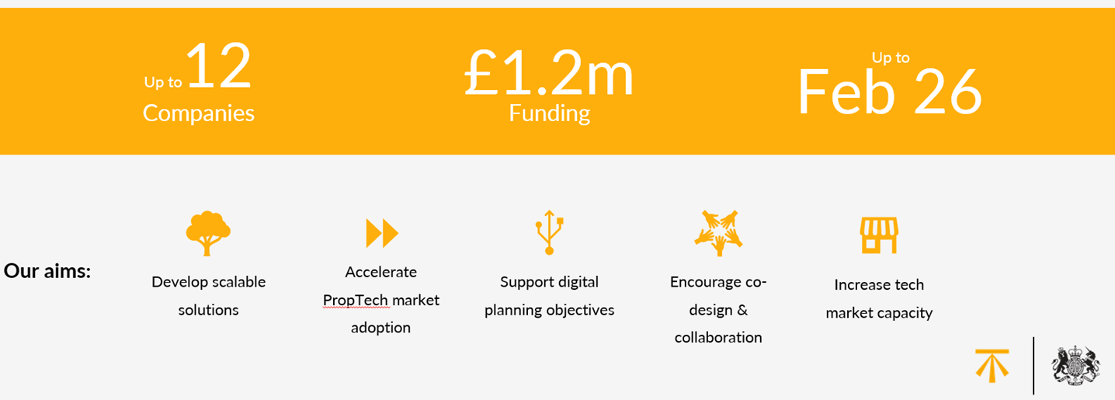
Geovation PropTech Challenge
Notes:
Tom

Slide 25
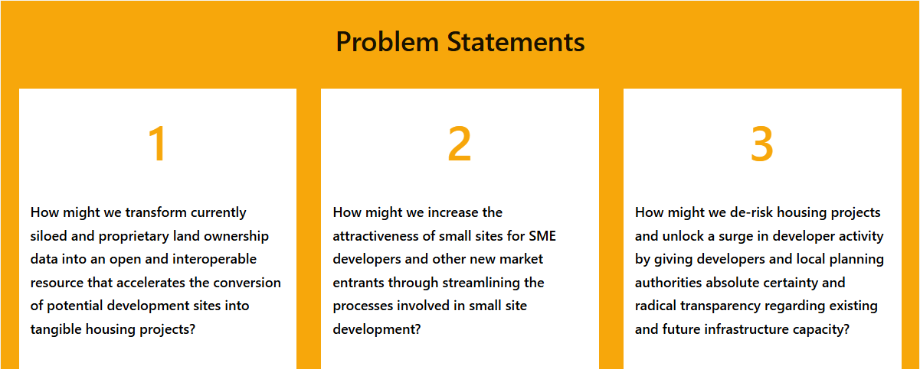
Notes:
Tom

Slide 26
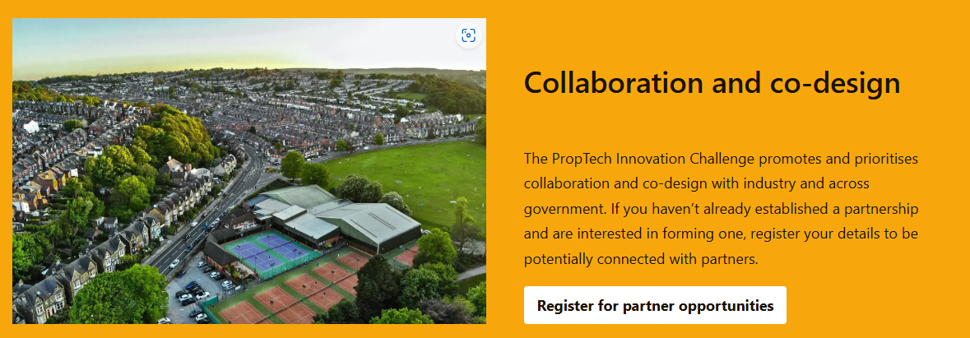
Notes:
Tom

Slide 27
User Research Support
We are looking for LPAs who can guide us through the process of planning applications at their council, with a focus on Development Management (validation, assessment, reporting) while considering interdependencies with other parts of the process. Ideal roles include Team Leads, Validation Officers, Planning Officers, Business Support, etc.
Please drop a message in this chat if you can support us or drop me a message on slack.
Thank you!
Notes:
Initially this will start with a series of online 101 introductory sessions that last 45mins – 1hr
The topics all align with the different categories of the Digital Planning Maturity Assessment
They will take place on Wednesdays 11:30 - 12:30.
If you are unable to attend at that time, all sessions will be recorded and shared on ODP Hub.
If you are part DPIF cohort 3, you will automatically receive an invite to each of the sessions - but attendance is optional!
I'm sending out invites to all sessions today. If you haven't received any, please let me know and I will add you to the list. You are also welcome to forward these sessions to relevant colleagues. The first session is Agile 101. Apologies for the short notice.More in-depth in-person and online training will be announced shortly.

Slide 28
Summary from today
Access the new ODP hub
Sign up to welcome events
Read the blueprints
Come along to learning sessions on Wednesdays
Geovation
User research support
Notes:
Tom

Slide 29
Thank you!

